Slide 1
PART 5 -b Radon transforms and MSSA
Mauricio Sacchi
University of Alberta

Slide 2
Noise attenuation with “TRANSFORM-BASED” methods
One possibility is to use PhotsShop. However, it is too time consuming for seismic data processing…

Slide 3
Noise attenuation with “TRANSFORM-BASED” methods
Note the isolation of
events in Transform Domain -> This is important for the transform to permit noise separation, reconstruction etc.

Slide 4
Noise attenuation with “TRANSFORM-BASED” methods
Note the isolation of
events in Transform Domain -> This is important for the transform to permit noise separation, reconstruction etc.

Slide 5
Noise attenuation with “TRANSFORM-BASED” methods
Note the isolation of
events in Transform Domain -> This is important for the transform to permit noise separation, reconstruction etc.

Slide 6
Radon transforms
Search for coherent waveforms along particular travel-time curves
Three common implementations: linear, parabolic, hyperbolic
Resolution is severely affected by amplitude variations and aperture
Resolution = Ability to distinguished events with similar moveout
HR implementations can cope with aperture problems but not with AVO.
AVO could be modeled but might be expensive and hard to parameterize for processing large batches of data.
Radon transforms are often used as non-local operators (Operator spans the full aperture of the gather) This is a problem as it entails the assumption of high degree of matching of the signal to the transform.
Solution: Going local - but again hard to parameterize

Slide 7
Companies often use the name
HIGH RESOLUTION RADON → SPARSE RADON TRANSFOMR
Is a RADON TRANFORM with FOCUSING of coefficients

Slide 8
Time Variant and Time Invariant Transforms
Parabolic and Linear → Time Invariant
Hyperbolic →Time Variant
In general, Time Invariant transforms lead to fast algorithms with operators with Toeplitz form.

Slide 9
Some refs.
High Resolution Hyperbolic RT [Time]
Thorson and Claerbout (GEOP, 1985)
Least-squares parabolic RT [Freq]
Dan Hampson (CSEG, 1986)
Sparse Parabolic RT (high-resolution) [Freq]
Sacchi and Ulrych – (GEOP, 1995)
De-aliased Parabolic RT (high-resolution) [Freq]
Phillippe Hermann et al – (SEG, 2000)
Latest views of the sparse Radon transform [Time and Freq]
Trad, Ulrych and Sacchi (Geop 2003)
Notes:
The Radon transform is an extension of the idea of using constant velocity stacks to separate primaries and multiples. It’s least-squares form, due to Dan Hampson, is a way of dealing with the irreversibility, or non-unitary, nature of the transform. Various authors have more recently revisited the constrained, regularised, inversion of the original work by Thorson and Claerbout on velocity stack inversion, which has led to the improved primary and multiple separation of the high-resolution transform.
We still rely critically, however, on the multiple kinematics after hyperbolic moveout correction being simple; in the usual implementation we rely on them being parabolic in form.

Slide 10
Radon Integration Traveltime Paths
time invariant curves
This is also a post-stack migration algorithm

Slide 11
Fourier shift theorem (Important)
Fourier delay theorem is used to design f-domain
Transforms:

Slide 12
Time and freq. domain forms for the PRT

Slide 13
These are the transforms that we do use…

Slide 14
Forward/Adjoint or Forward/Transpose transform pair
Forward or Synthesis
Adjoint
The hat is important (discuss it)

Slide 15
Key points about Radon
The adjoint is not the inverse (unless the operator is orthogonal)
Time or Freq. Let’s write the problem in Matrix or Operator form
We write our data d as the sum of events in Radon space m
We also add noise and modeling errors

Slide 16
Find the Radon Panel via the solution of an inverse problem
Time domain RT: Solve all at once
Freq. domain RT: Solve one small IP for each frequency

Slide 17
Some nice features of freq domain RT
Toeplitz structure
Toeplitz if and only if q-axis is regularly sampled. This leads to fast algorithms.
Valid for the linear and parabolic cases (time-invariant) and for the time-invariant hyperbolic transform proposed by Mosher and Foster (Geophysics 1992)

Slide 18
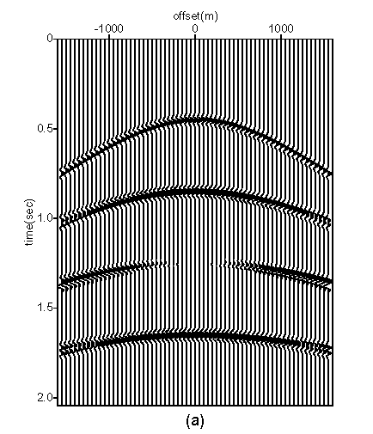
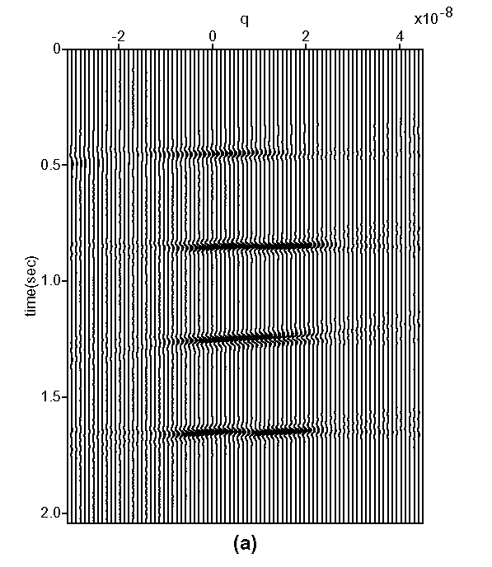
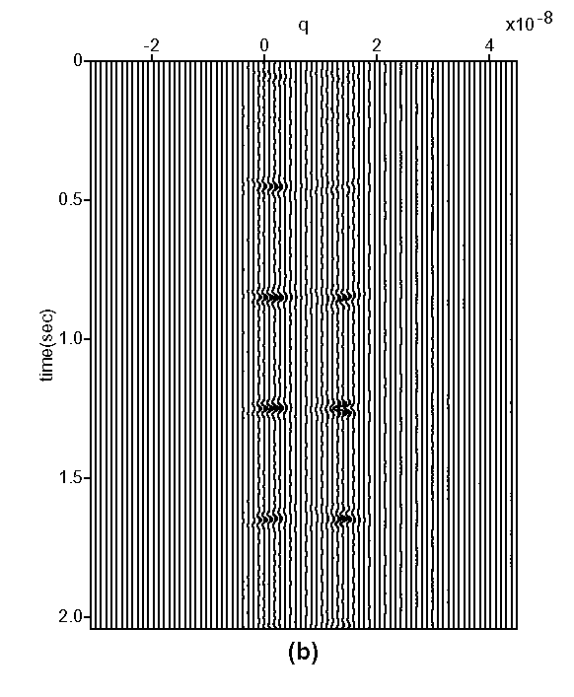
Improving resolution
P
P
P
M
P+M
P
M
P+M
P
M
P+M
smooth model
sparse model
Notes:
However, more important is the fact that sparse models facilitate separation of events in the transformed domain by their inherent localization.
These synthetic data set appears to have four events under smooth eyes,
but in fact it happens to have seven events under the sharp view of the sparse RT. Here we see the increasing of resolution when we go from smooth to sparse models.

Slide 19
Improving resolution
LS PRT Radon (Toeplitz)
HR PRT Radon
P
P
P
M
P+M
P
M
P+M
P
M
P+M
smooth model
sparse model
Notes:
However, more important is the fact that sparse models facilitate separation of events in the transformed domain by their inherent localization.
These synthetic data set appears to have four events under smooth eyes,
but in fact it happens to have seven events under the sharp view of the sparse RT. Here we see the increasing of resolution when we go from smooth to sparse models.

Slide 20
Flavors of Freq. domain RT (Sparse or Hi-Res Radon)
All high res methods must use weights with that form. Why?
Notes:
However, more important is the fact that sparse models facilitate separation of events in the transformed domain by their inherent localization.
These synthetic data set appears to have four events under smooth eyes,
but in fact it happens to have seven events under the sharp view of the sparse RT. Here we see the increasing of resolution when we go from smooth to sparse models.

Slide 21
Flavors of Freq. domain RT
Notes:
However, more important is the fact that sparse models facilitate separation of events in the transformed domain by their inherent localization.
These synthetic data set appears to have four events under smooth eyes,
but in fact it happens to have seven events under the sharp view of the sparse RT. Here we see the increasing of resolution when we go from smooth to sparse models.

Slide 22
Flavors of Freq. domain RT (I. Moore)
Notes:
However, more important is the fact that sparse models facilitate separation of events in the transformed domain by their inherent localization.
These synthetic data set appears to have four events under smooth eyes,
but in fact it happens to have seven events under the sharp view of the sparse RT. Here we see the increasing of resolution when we go from smooth to sparse models.

Slide 23
Comparison of Least-squares (Smooth) versus
Sparse (high-res) Radon transform → IRLS

Slide 24
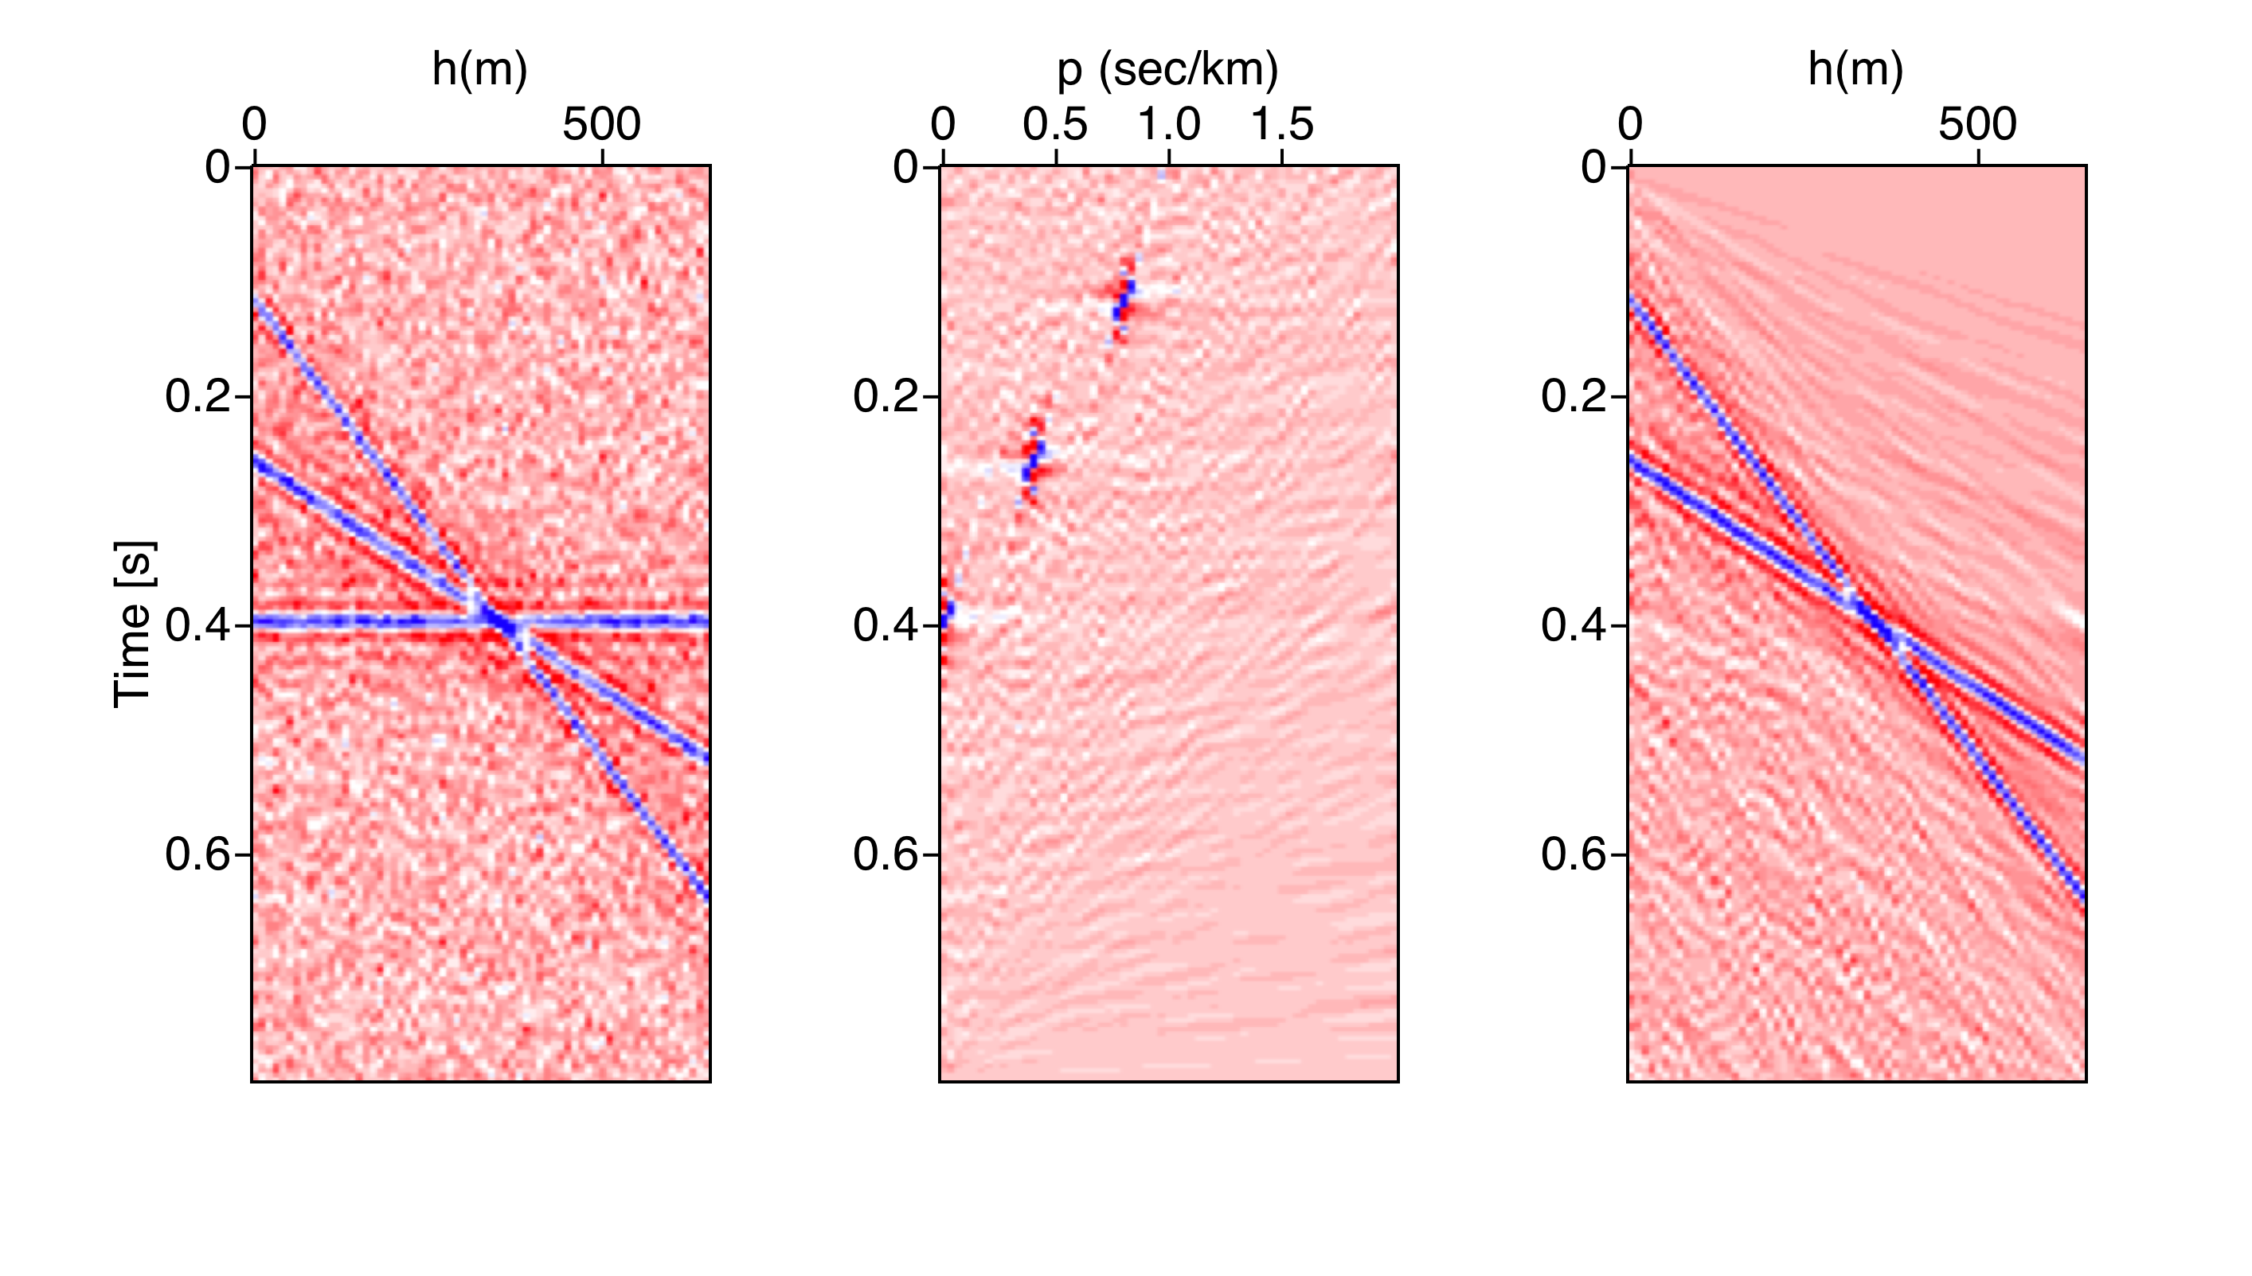
Linear Radon Transform
Data in Radon Domain
Recovered data after filtering the horizontal event
Data

Slide 25
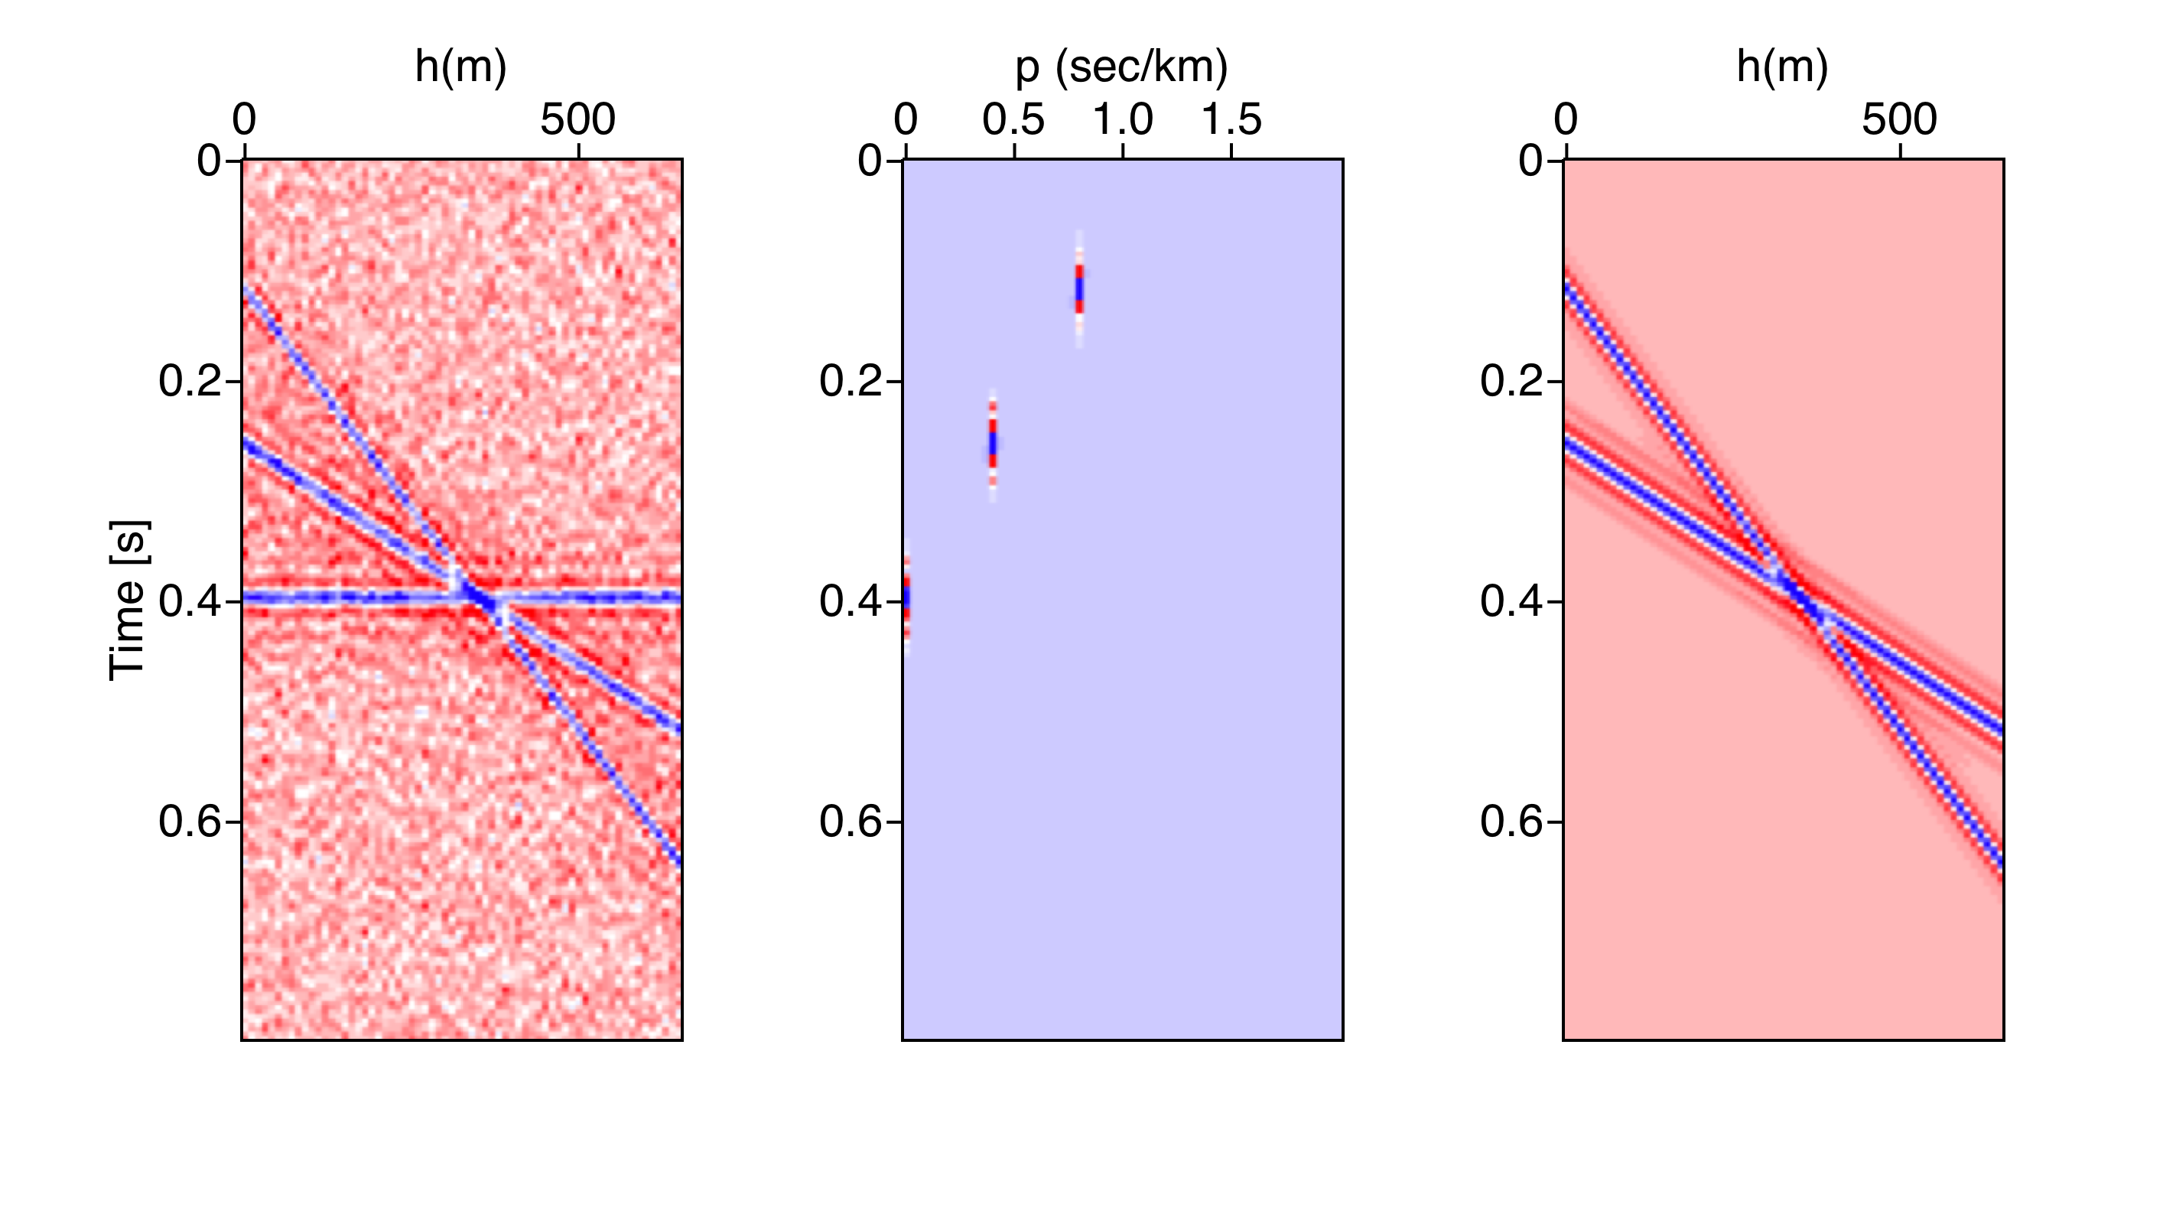
Linear Radon Transform
Data in Radon Domain
Recovered data after filtering the horizontal event
Data

Slide 26
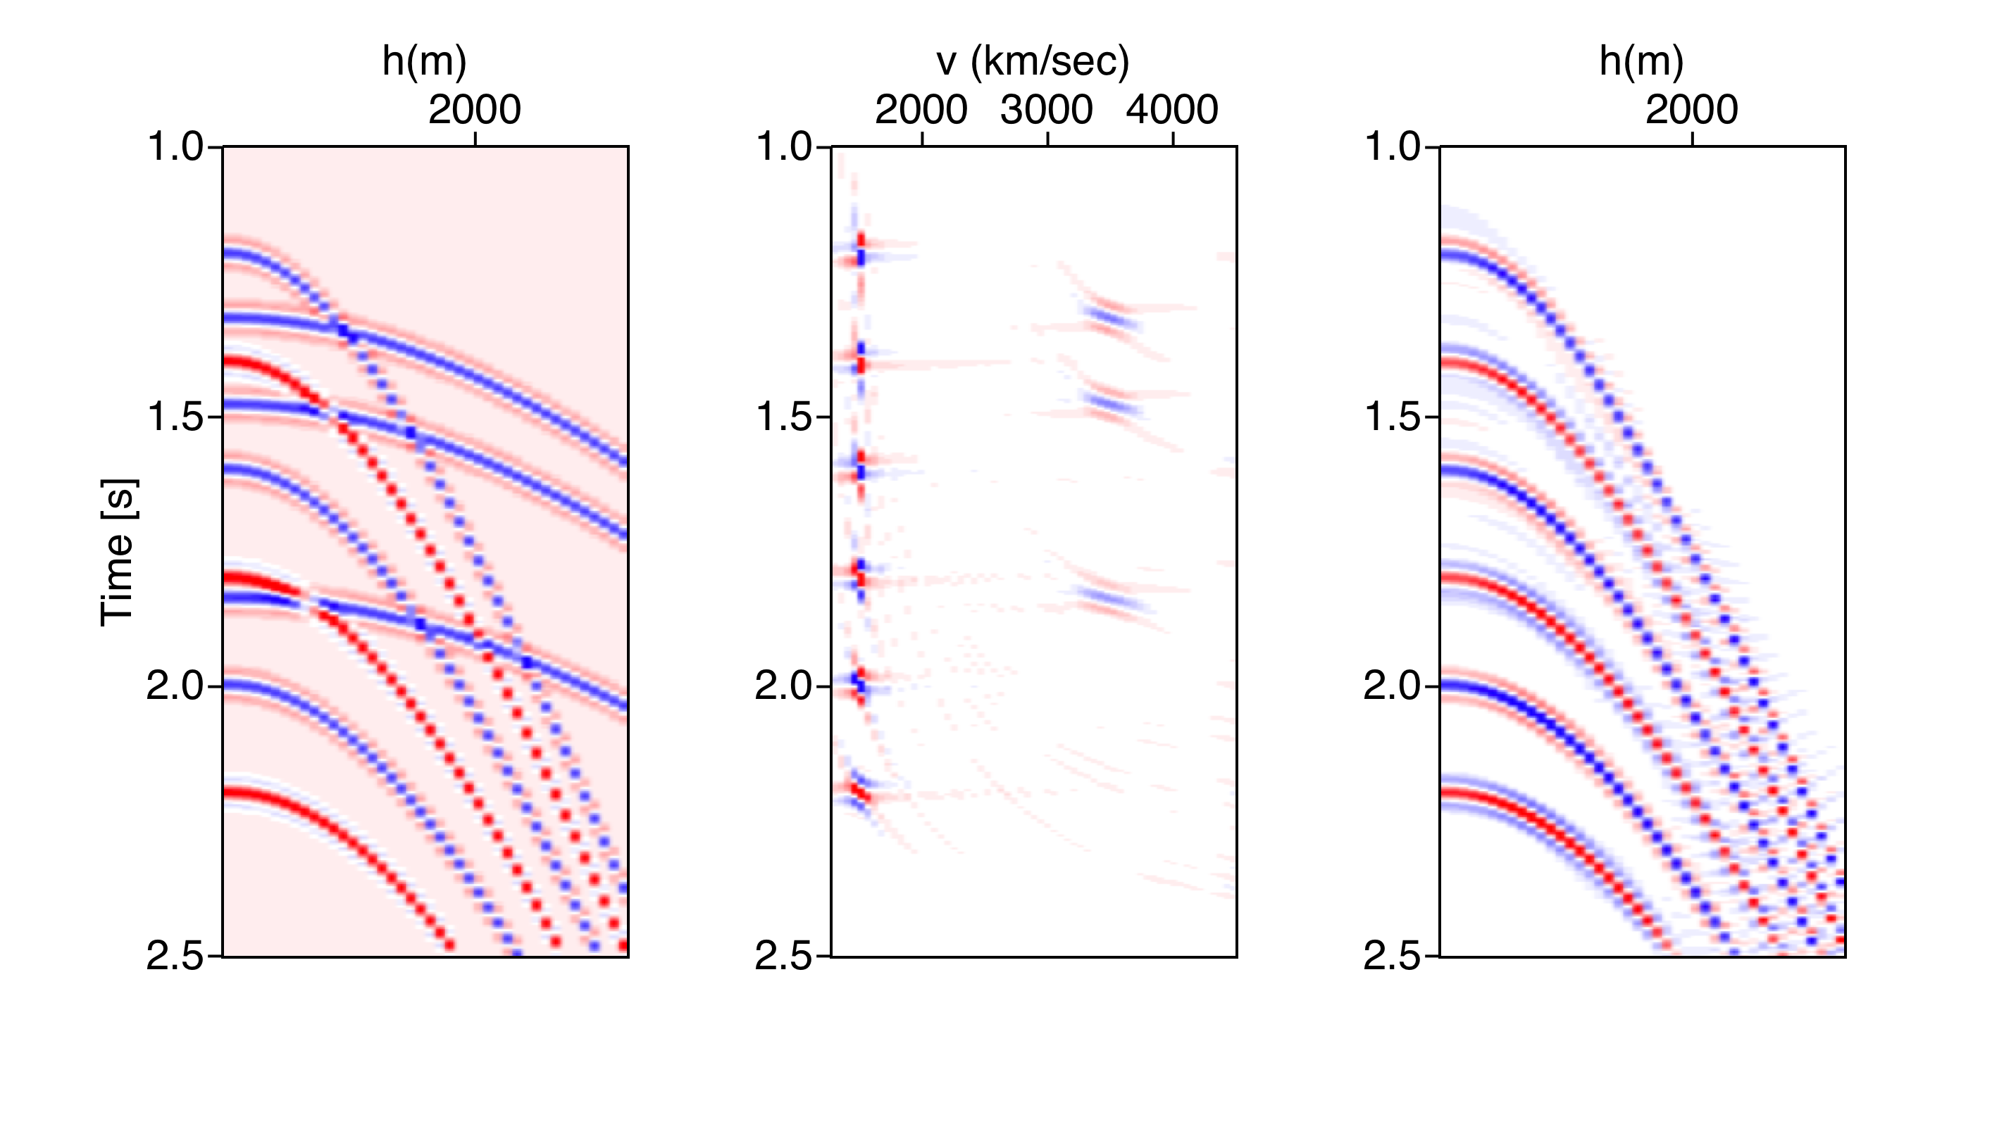
Hyperbolic Radon Transform

Slide 27
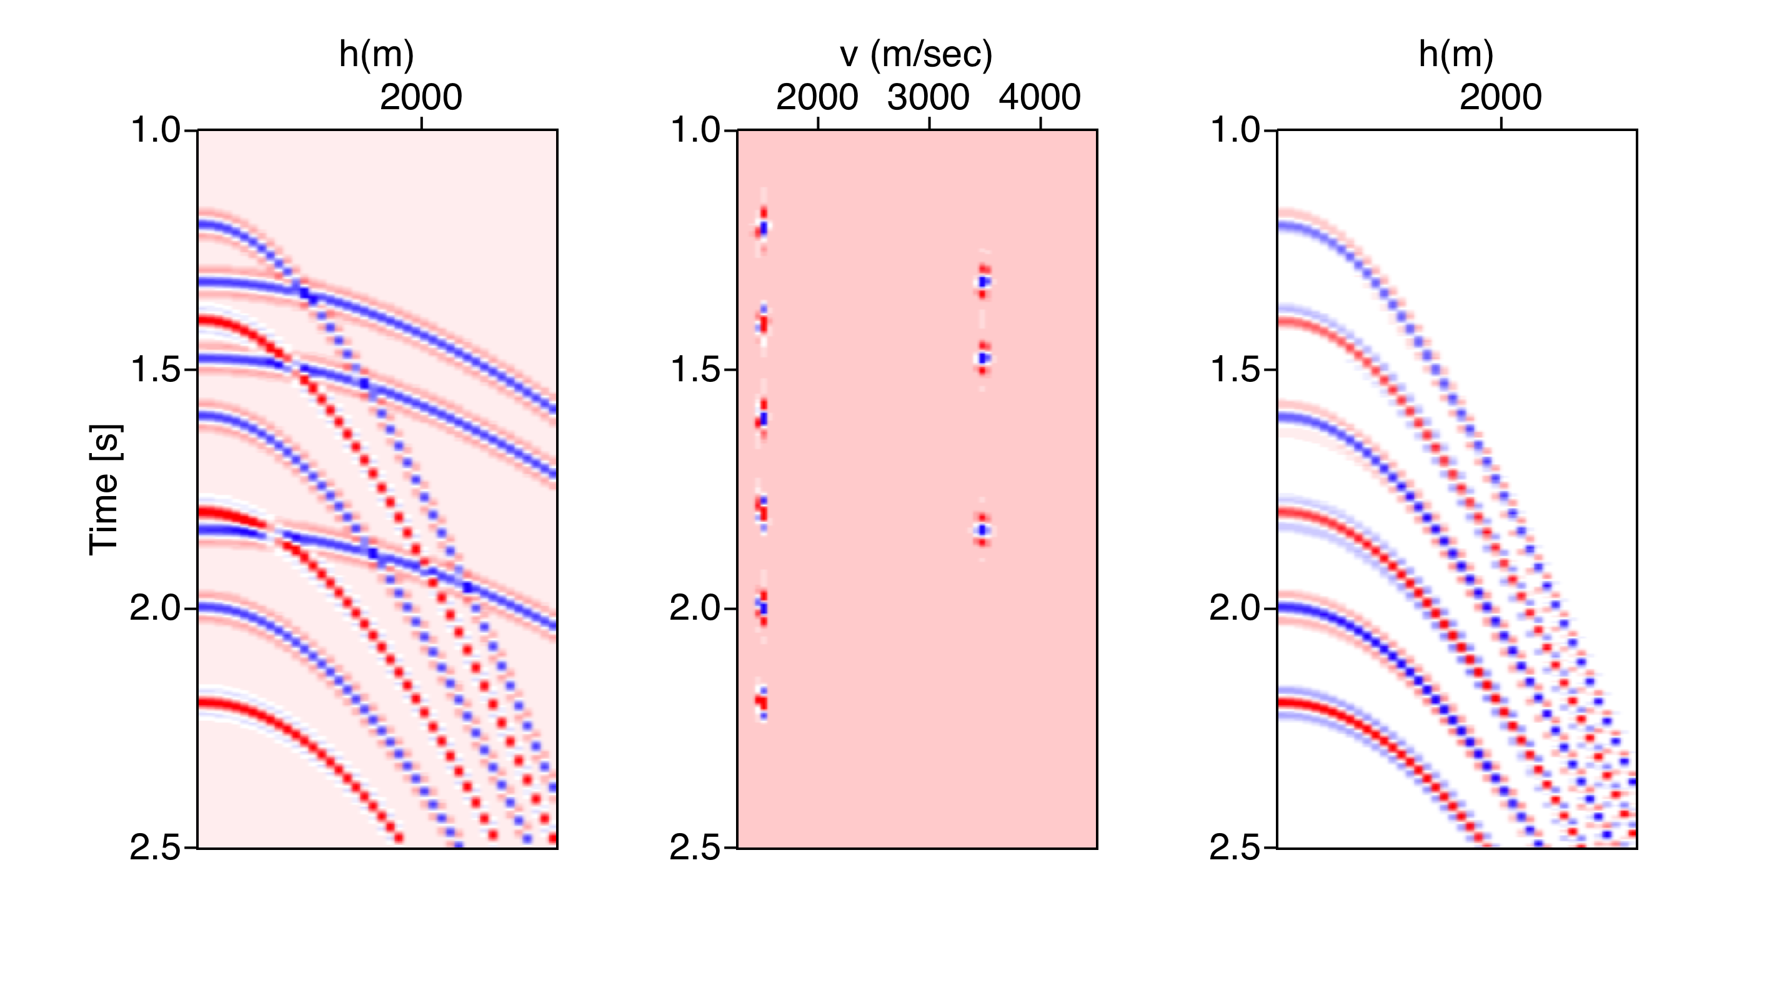
Hyperbolic Radon Transform

Slide 28
Parabolic Radon Transform: A note on q
q is residual moveout at far offset (in secs)
Hyperbolic traveltimes after NMO correction can be approximated by parabolic traveltime curves.

Slide 29
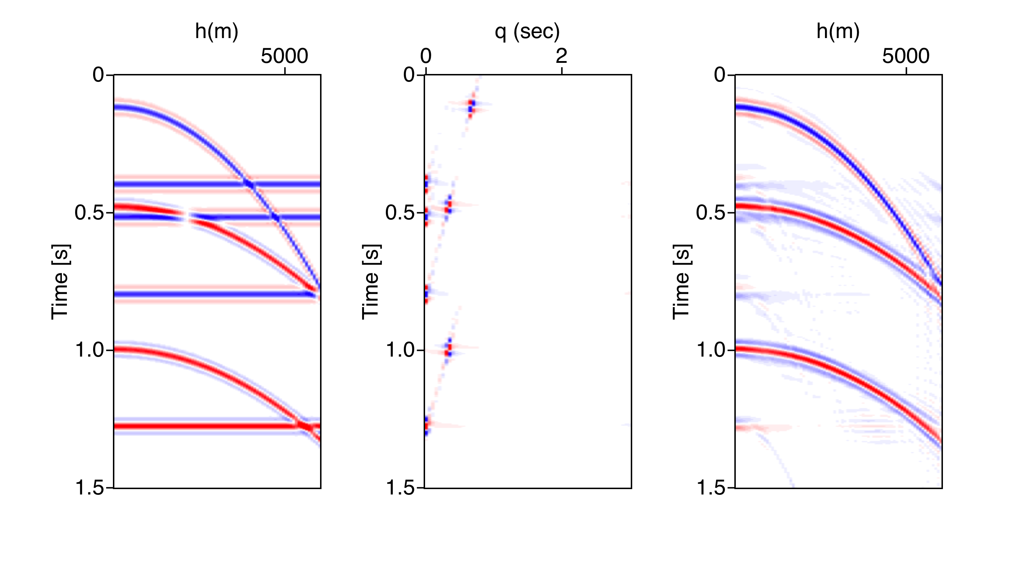
Parabolic Radon Transform

Slide 30
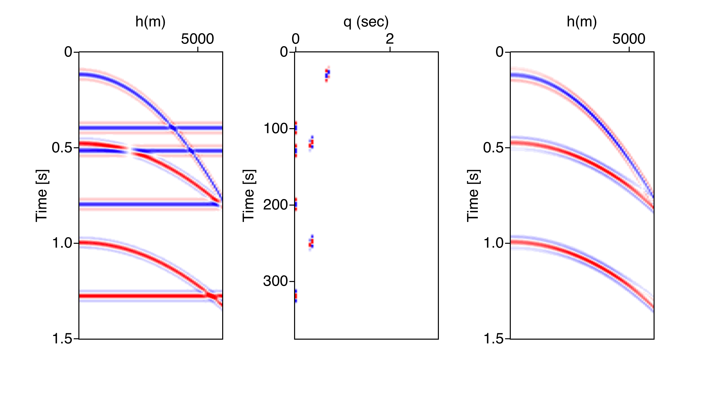
Parabolic Radon Transform

Slide 31
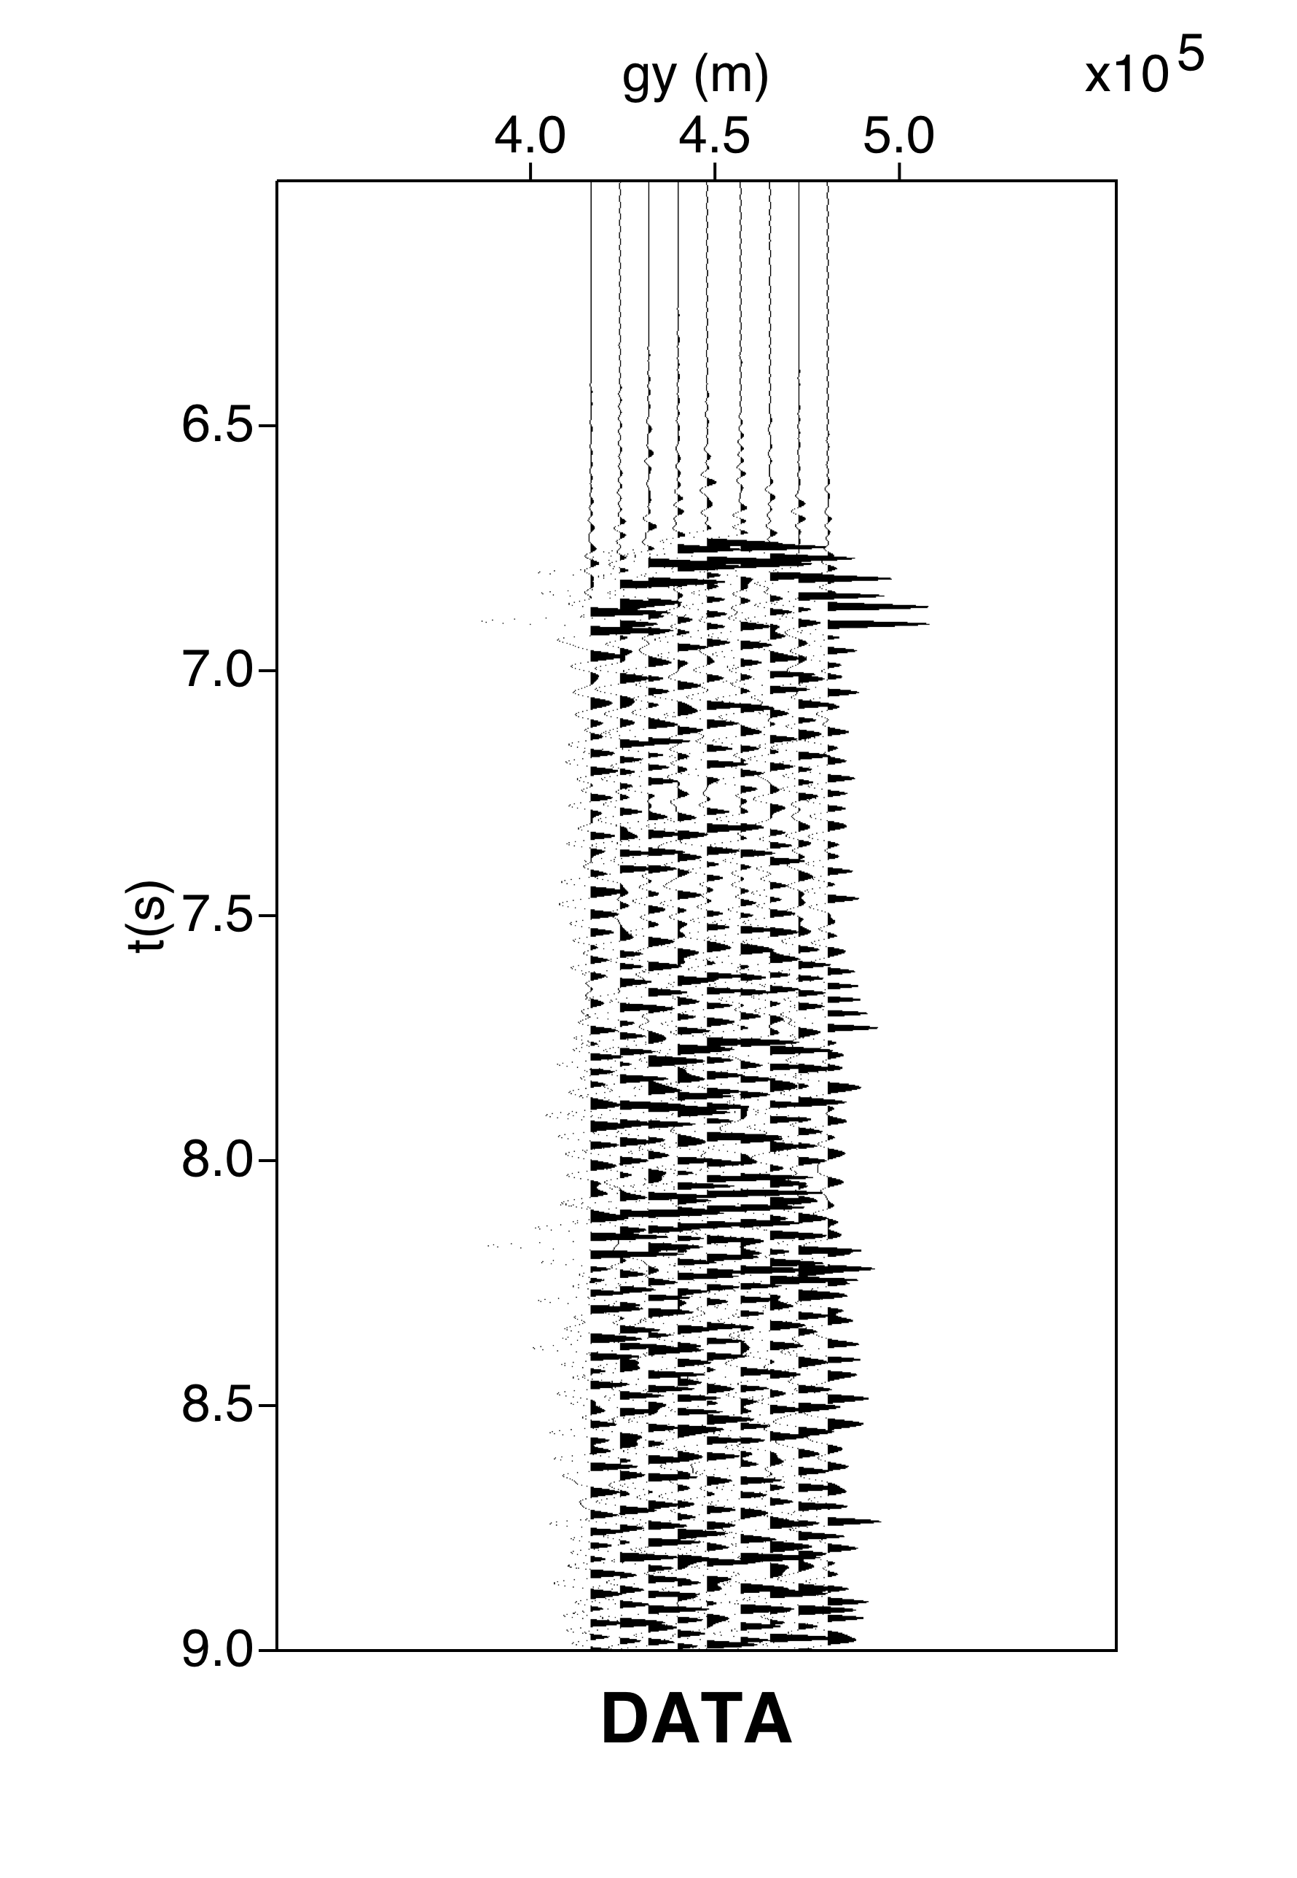
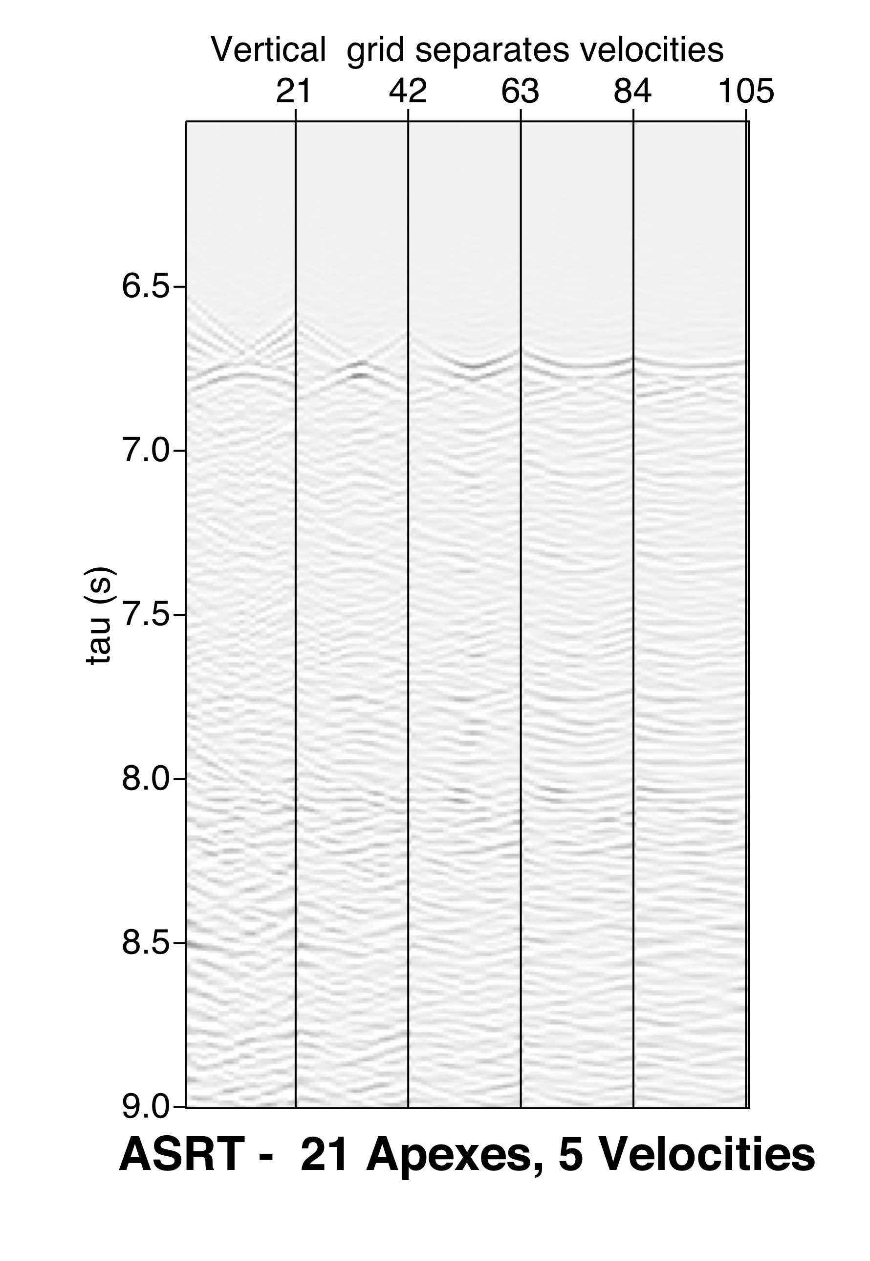
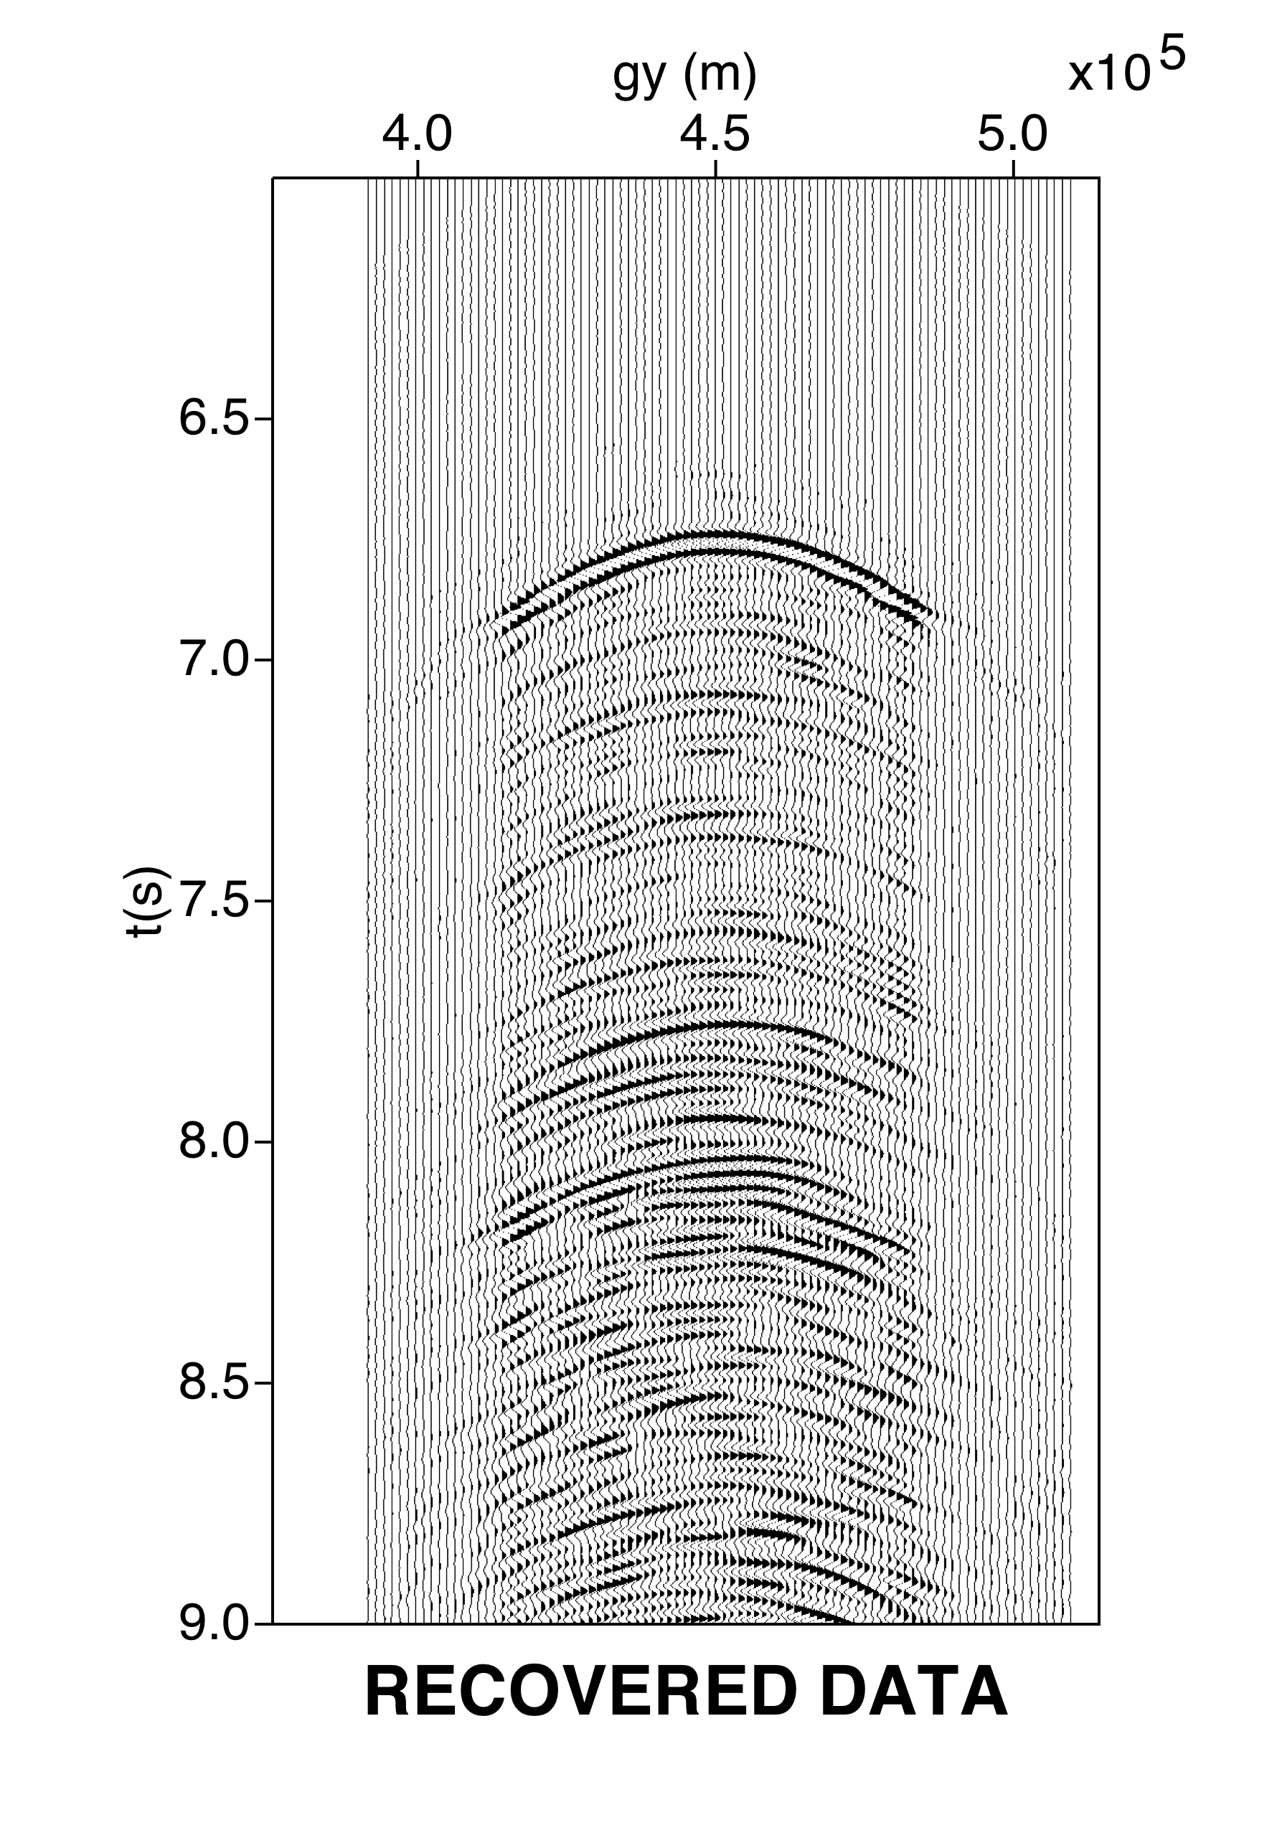
Hyperbolic Radon Transform with apex

Slide 32

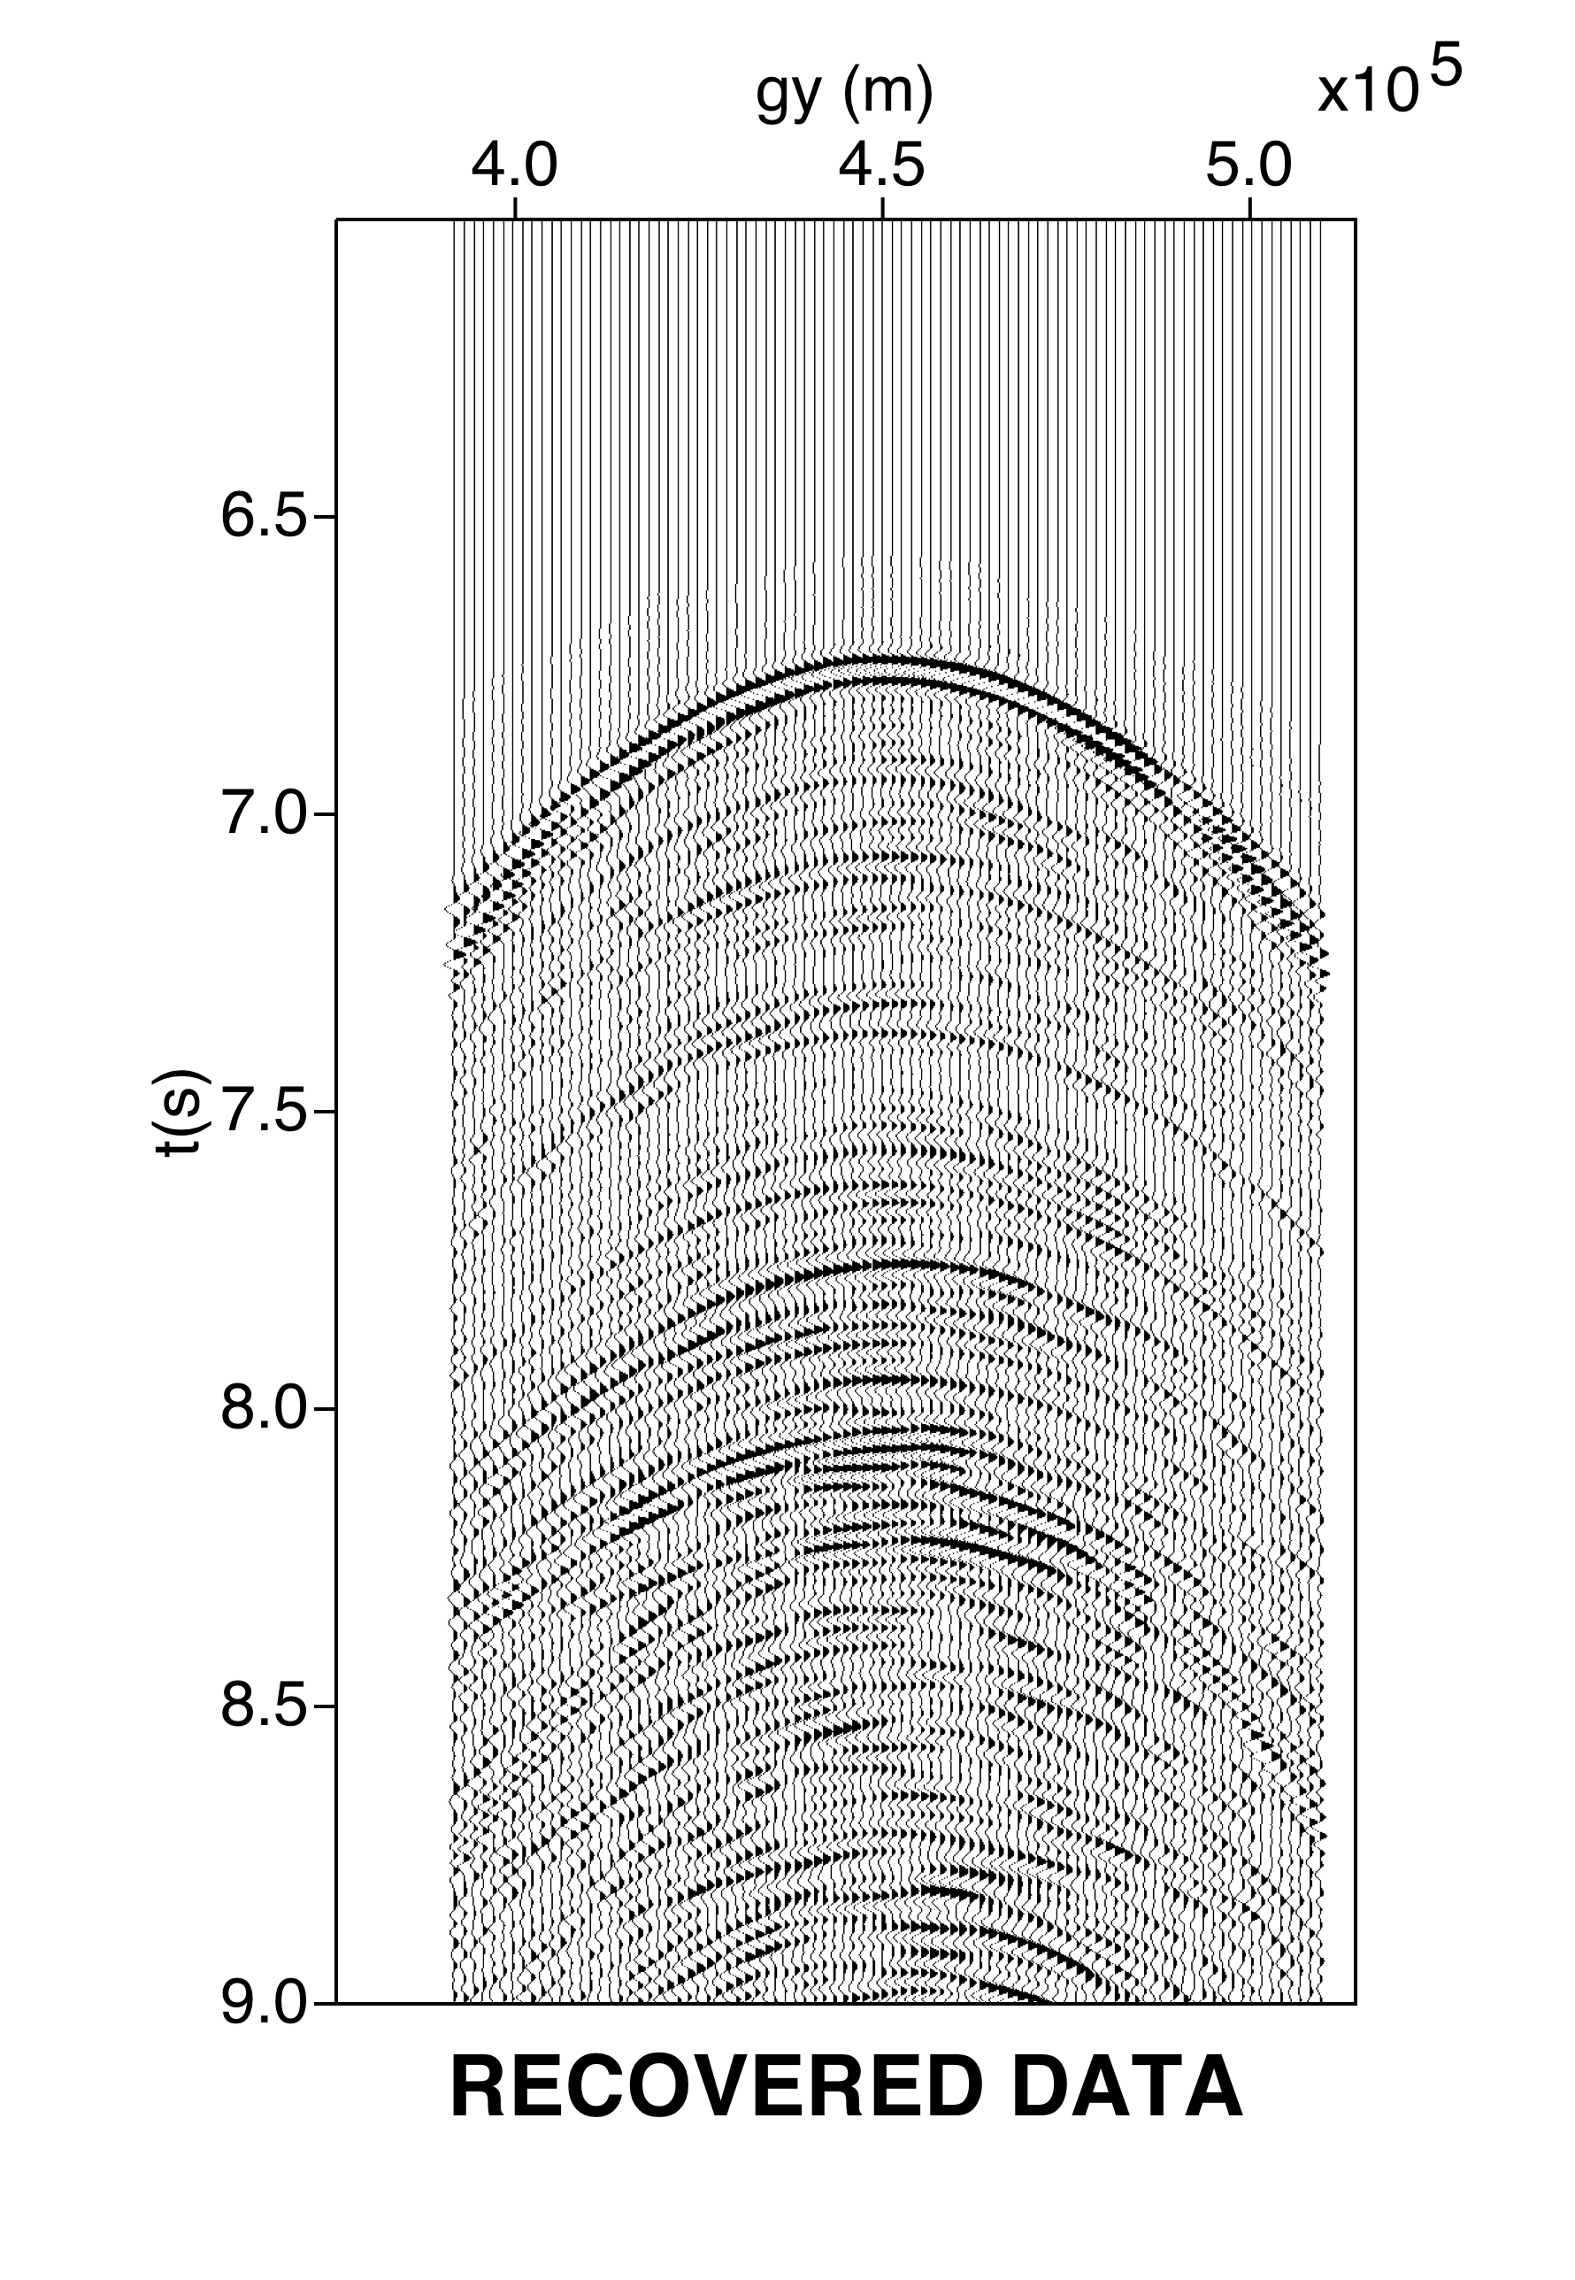
Hyperbolic Radon Transform with apex

Slide 33
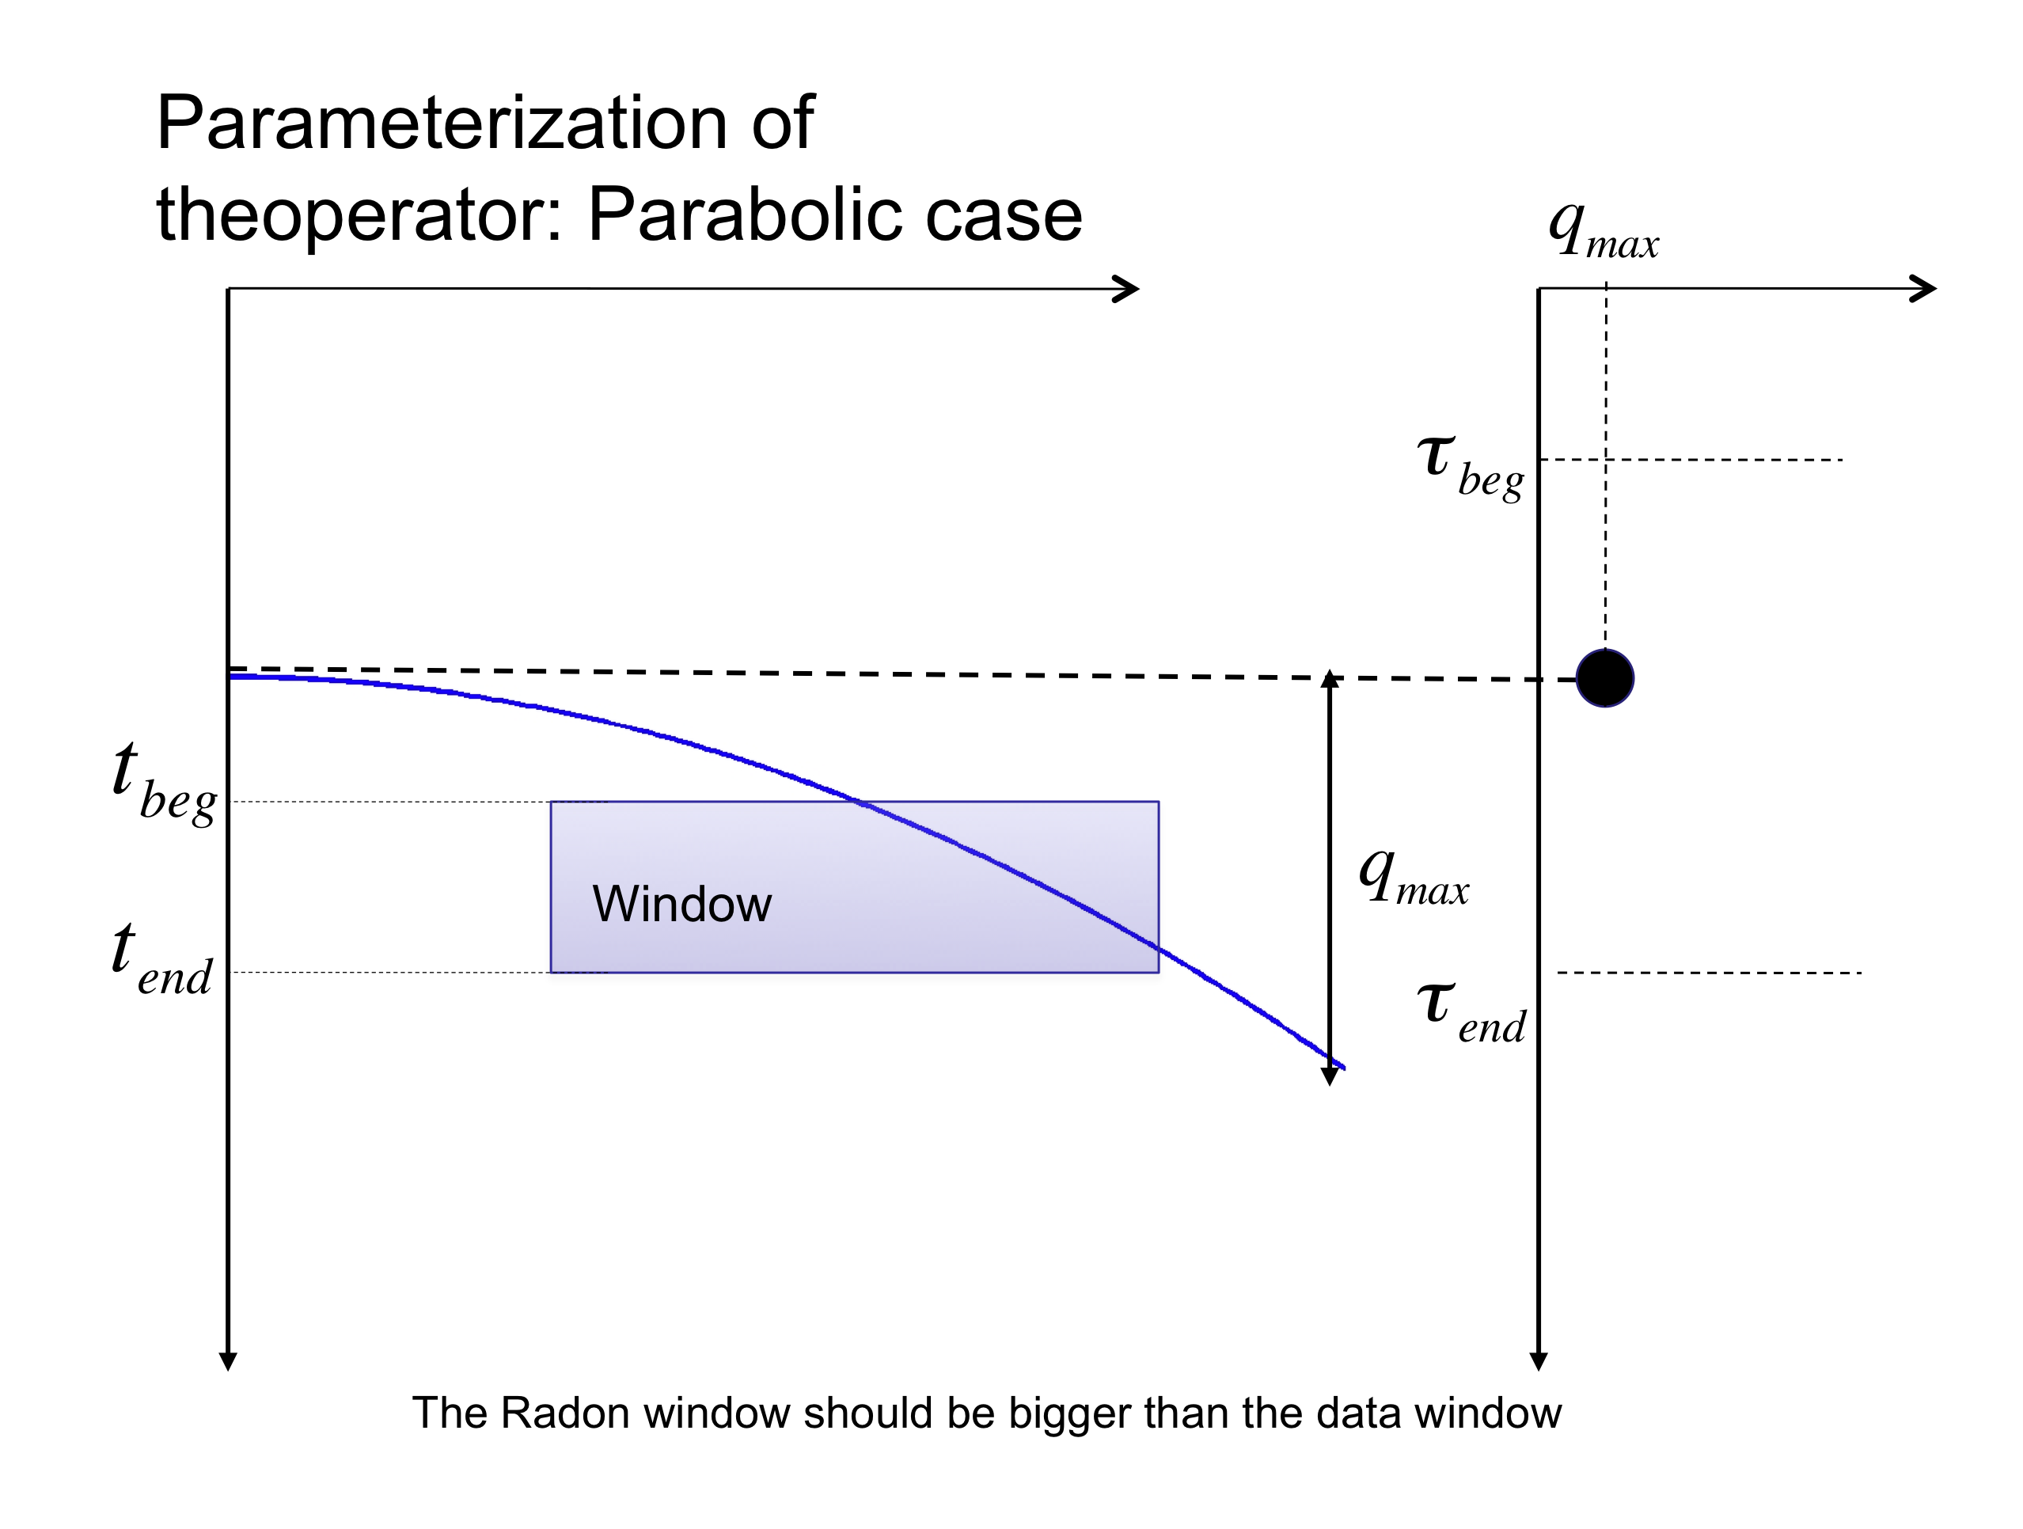
Warning: Sparsity works better in small windows
(similar problem in MED-Deconv, Sparse decon, etc)

Slide 34
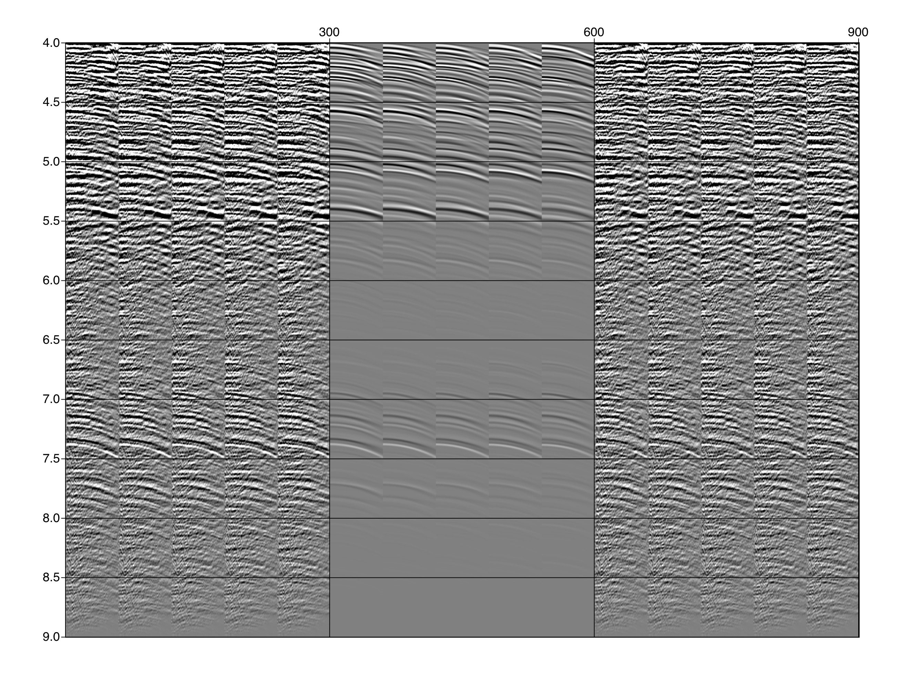
Single window HR Radon Transform

Slide 35
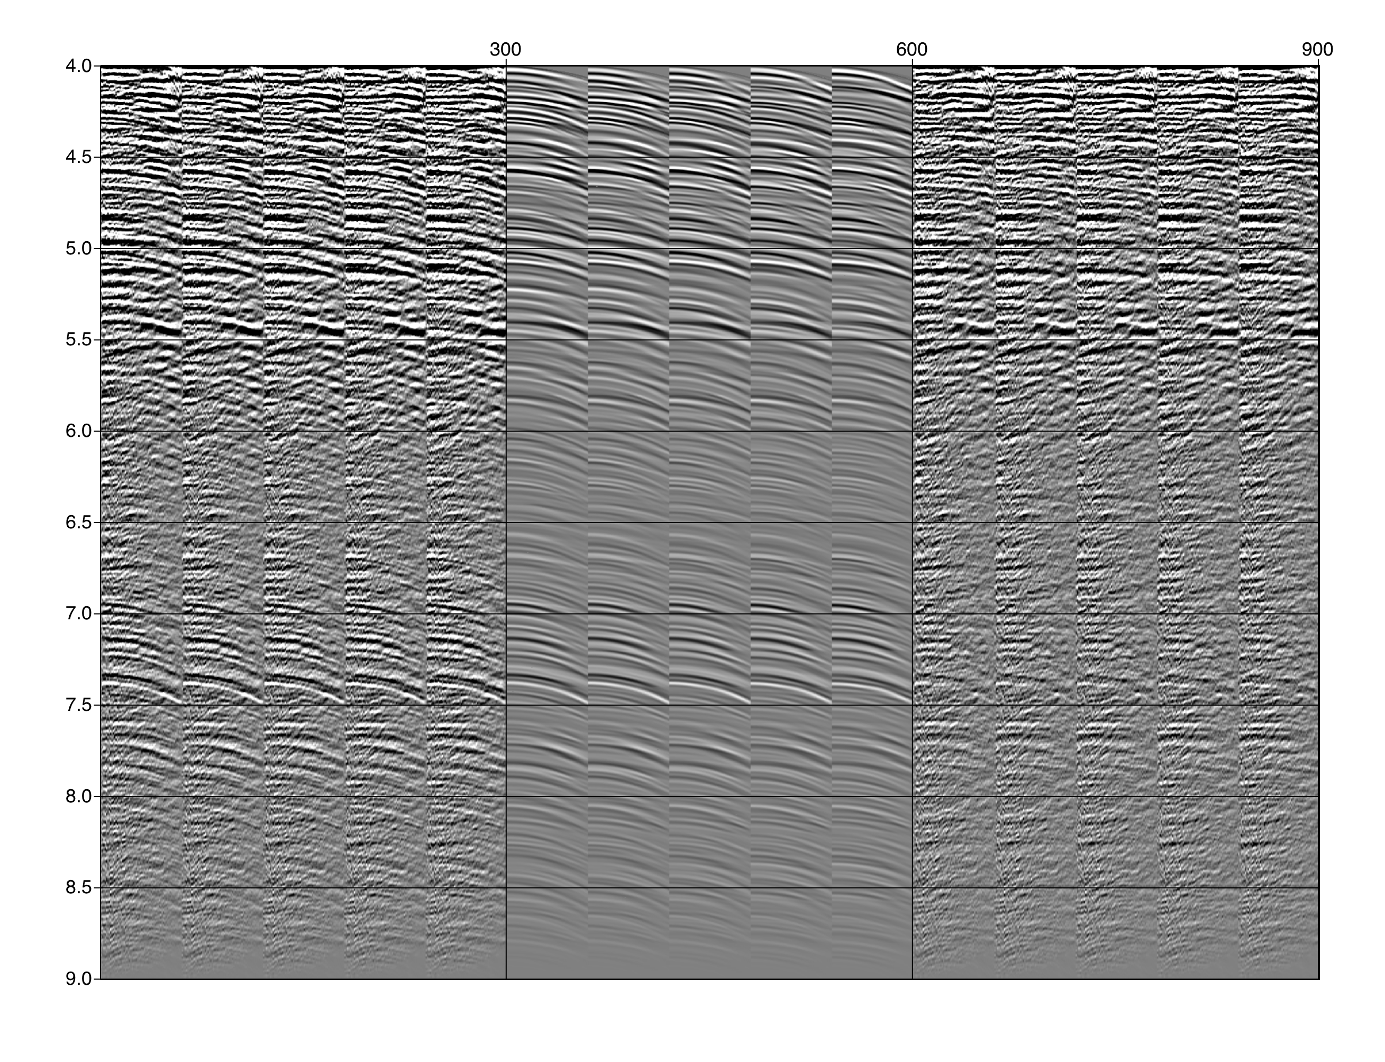
Small window HR Radon Transform

Slide 36
Hybrid Radon Transform
Like a dictionary of Radons
Trad, Sacchi and Ulrych, 2001, JSE

Slide 37
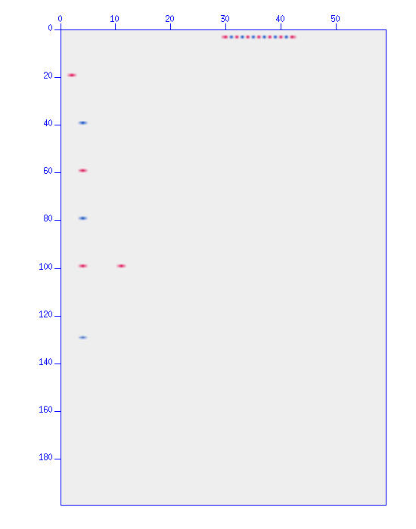
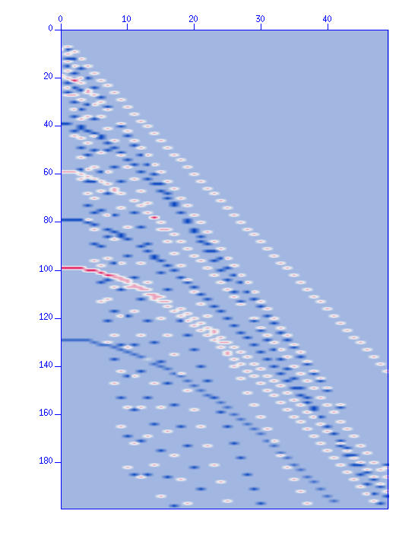
Hybrid Radon Transform
v
p
v
p
m
d
Inverted m
Sparse Inversion
Notes:
Calrify that superreolsution + attenuation of cross-talk was possbile because of the High res. Apporoach-

Slide 38
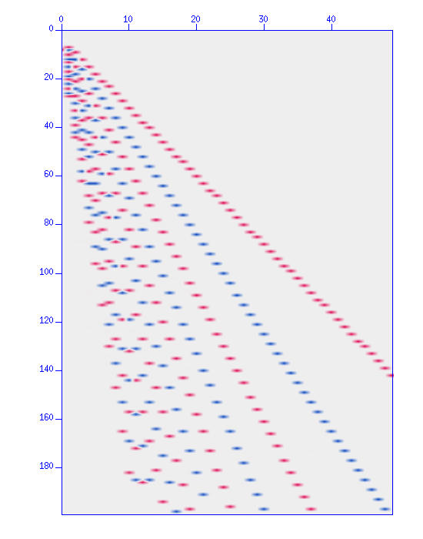
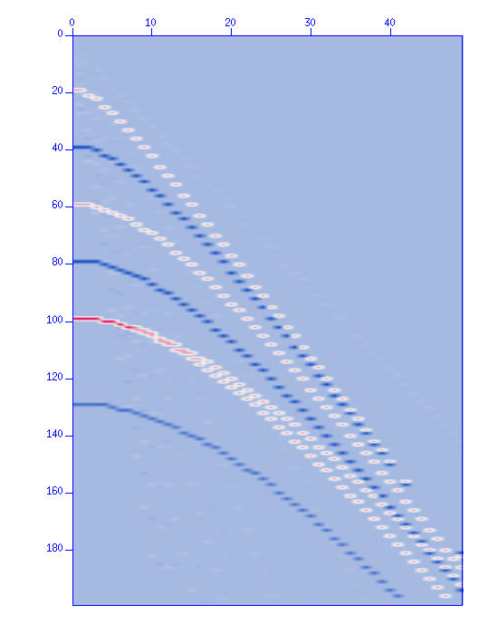
Hybrid Radon Transform
Recovered Model of linear events
Recovered model of hyperbolic events

Slide 39
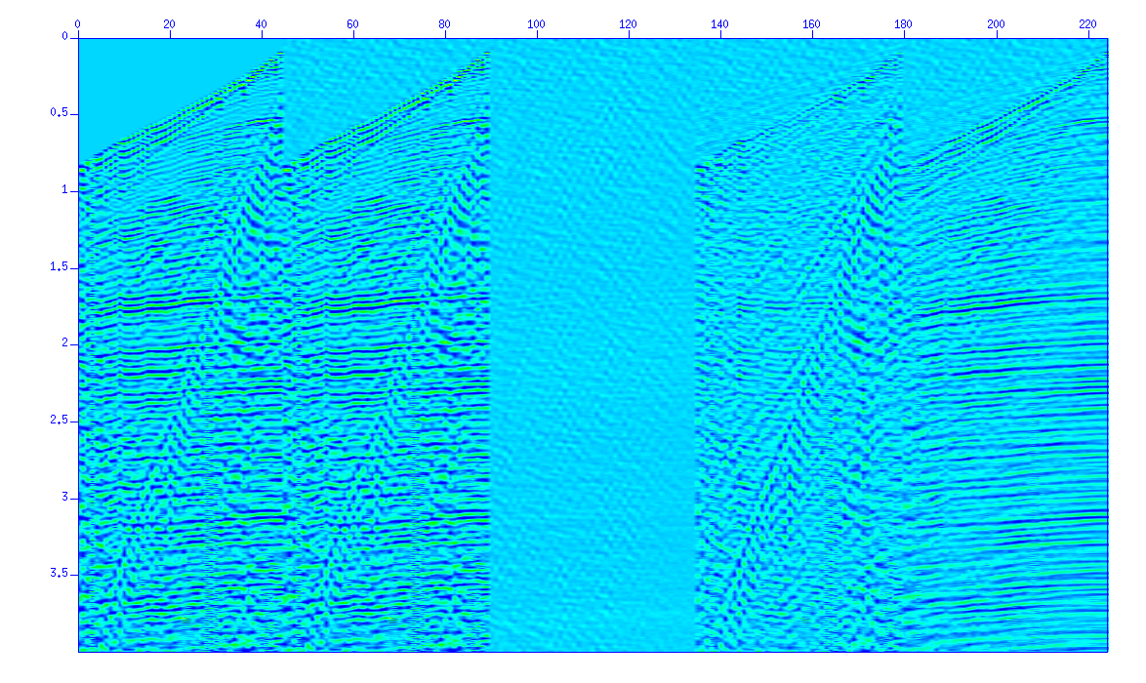
Hybrid Radon
Observations Prediction Residuals Linear Noise Signal
Notes:
The 2 panel is for testing the we do have the right inverse - The same is the 3rd.

Slide 40
The Linear Event Model: FX Decon and Cazdow / SSA filters
Mauricio Sacchi
University of Alberta, Edmonton, AB, Canada

Slide 41
Deconvolution in F-X
Why f-x?
Linear events in t-x are predictable in f-x

Slide 42
A Model for FX data (One event)
Time Domain Delay Frequency Domain Linear Phase

Slide 43
A Model for FX data (One event)
Time Domain Delay Frequency Domain Linear Phase:
Same model as a function of Wave-number:

Slide 44
A Model for FX data (One event)
We now consider the problem as one of predicting data along the spatial coordinate for fix temporal frequency
Take for instance a linear event in t-x with the above representation in f-x, we write:

Slide 45
A Model for FX data (One envent)
From last expression, we can derive a recursive relation between the signal recorder at receiver j as a function of the signal at receiver j-1
The last simple expression is the basis for f-x prediction/deconvolution and snr enhancement
If the signal can be predicted, then the non-predictable part must be the noise
Canales, L. L., 1984, Random noise reduction: 54th Annual International Meeting, SEG, Expanded Abstracts, Session:S10.1.
Gulunay, N., 1986, FX decon and complex Wiener prediction filter: 56th Annual International Meeting, SEG, Expanded Abstracts, Session:POS2.10.
Gulunay, N., 2000, Noncausal spatial prediction filtering for random noise reduction on 3-D poststack data: Geophysics, 65, 1641-1653.

Slide 46
A Model for FX data (One event)
From last expression, we can derive a recursive relation between the signal recorder at reciever j and a function of the signal at receiver j-1
Determine a from available data the estimate noise
System of equations from where one can estimate a and the noise (Least Squares!)

Slide 47
A Model for FX data (NP events)
We can prove that if the data consists of NP linear events

Slide 48
A Model for FX data (NP events)
We can prove that if the data consists of NP linear events
The coefficients of the recursion are also called prediction error coefficients - They are related to the wavenumber of each linear event
Recursion of order NP

Slide 49
A Model for FX data (Adding noise)
LF (not NP) coefficients ??
We now consider also noise:
Suppose LF=3 and nx=24 channels
Notice that I have added noise

Slide 50
A Model for FX data (Using the available information)
Ignoring non-recorded data (Using available information only !)

Slide 51
A Model for FX data (Assuming data outside aperture=0)
Considering non-recorded data = 0

Slide 52
A Model for FX data (Assuming data outside aperture=0)
Considering non-recorded data = 0

Slide 53
A Model for FX data (NP events)
Two formulations:
Two Least Squares Solutions:

Slide 54
A Model for FX data (Algorithm)
Algorithm to recover the noise

Slide 55
A Model for FX data (Trade-off parameters)
NP does not define the filter length LF (Number of coefficients of the prediction error operator a.)
LP=LF only if the data is a superposition of NP linear events and noise=0
In general, events in the data are approximated by linear events. In addition, data are contaminated with random noise, then we choose LF > NP
Similar to the deconvolution problem, we can also add a stability factor:

Slide 56
A Model for FX data (Trade-off parameters)
LF and control the degree of noise that is modeled
Long operators will attempt to model the signal and the noise and therefore, the noise estimate will be contaminated by the signal
Short filters will only partially model the noise
FX DECON needs small overlapping windows. Why?.. Because assumes windows with constant dip data…… and a small number of dips. OK!!

Slide 57
Why the name F-X Deconvolution ?
f predicts white noise - in spiking deconvolution f also predicts white noise (the reflectivity)

Slide 58
Prediction error filter - A wave number view

Slide 59
Fxy Filters
2D Kernels - same idea but not clear to what kind of signal model one requires to justify 2D prediction error filters
1D Prediction can be performed with Forward or backward operators or a combination of both

Slide 60
Fxy Filters
y
x
Solution: could use Block Matrices and Block Solvers or operate on the flight with the Method of Conjugate Gradients

Slide 61
SSA Singular Spectrum Analysis or Cadzow Filter
SSA: an alternative to FX deconvolution ?
++
Easy to code and to understand
Easy to extend to ND
Possibility of creating noise attenuation methods that simultaneously operate in frequency and space
-+
Memory?
Note:
SSA arises from people working in dynamical systems as a method for rank reduction of 1D time series. Cadzow decomposition is a more general approach to image/signal enhancement that leads to an algorithm very similar to SSA when used to enhance complex sinusoids.

Slide 62
References
S. Trickett, 2008,F-xy Cadzow noise suppression, CSPG CSEG Convention
Broomhead, D.S., and King, G., 1986: Extracting qualitative dynamics from experimental data, Physica D, 20, 217-236.
Vautard, R., and Ghil, M., 1989: Singular spectrum analysis in nonlinear dynamics, with applications to paleoclimatic time series, Physica D, 35, 395-424.
V Oropeza and M D Sacchi, 2011, Simultaneous seismic data de-noising and reconstruction via Multichannel Singular Spectrum Analysis (MSSA), Geophysics, 76, V25-V32.

Slide 63
Theory (an easy tour of SSA) Assume we are in FX working with data in x for fixed f
Hankel Matrix of a signal of length 7 with a view of length M=4 (Trajectory Matrix)

Slide 64
Hankel Matrix of a signal of length 7 with a view of length M=4 (Trajectory Matrix)

Slide 65
Average Along anti-diagonals

Slide 66
Linear event in TX = Complex Sinusoid in FX

Slide 67
Prediction operator of length 1 is able to propagate signal from channel n-1 to channel n.

Slide 68
Single linear event in FX

Slide 69
Single linear event in FX
M is a Hankel matrix of Rank = 1

Slide 70
p linear events
It can be shown that for a superposition of p complex sinusoids (p events of different slope in FX):
M is a Hankel matrix of Rank =p

Slide 71
We will use rank reduction to attenuate random noise
The spectra of singular values can be used to determine the number of complex sinusoids (plane waves) in the window of analysis

Slide 72
SSA FX algorithm = Rank Reduction of M

Slide 73
The Cazdow/SSA filter
Hankelization Operator
Rank Reduction Operator
Anti-diagonal Averaging Operator
Cazdow/SSA Filter

Slide 74
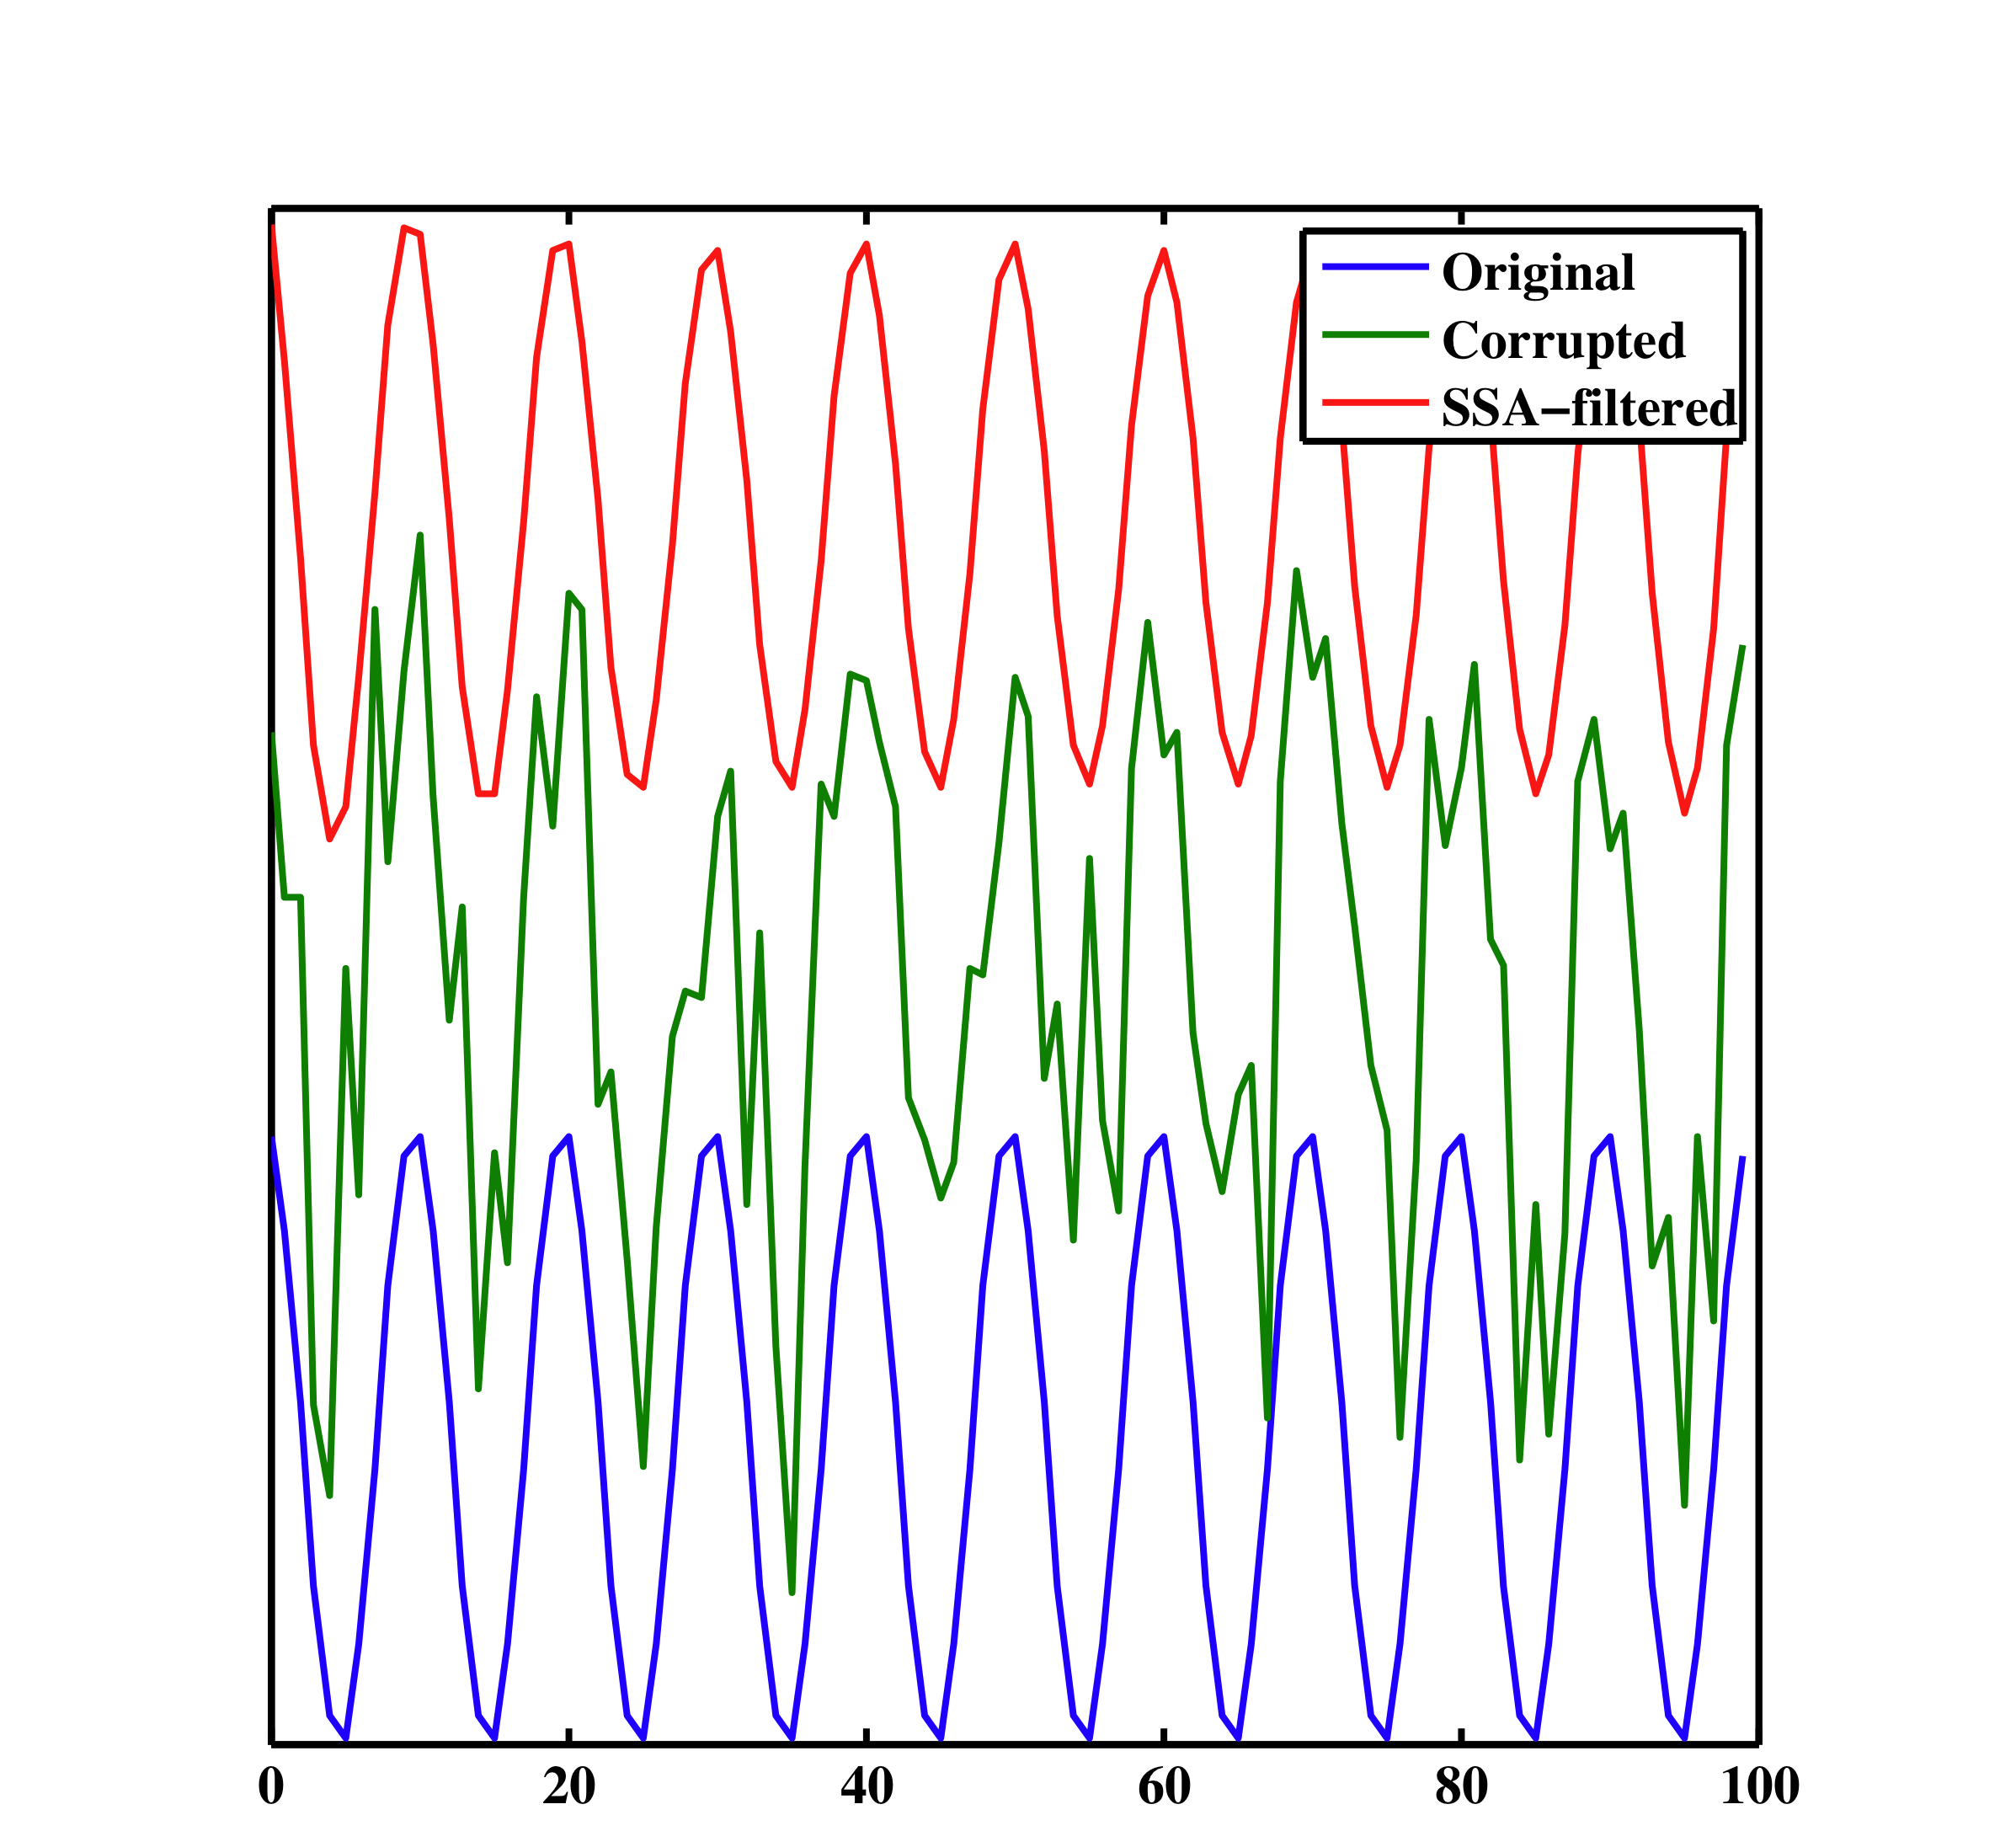
1D Example

Slide 75
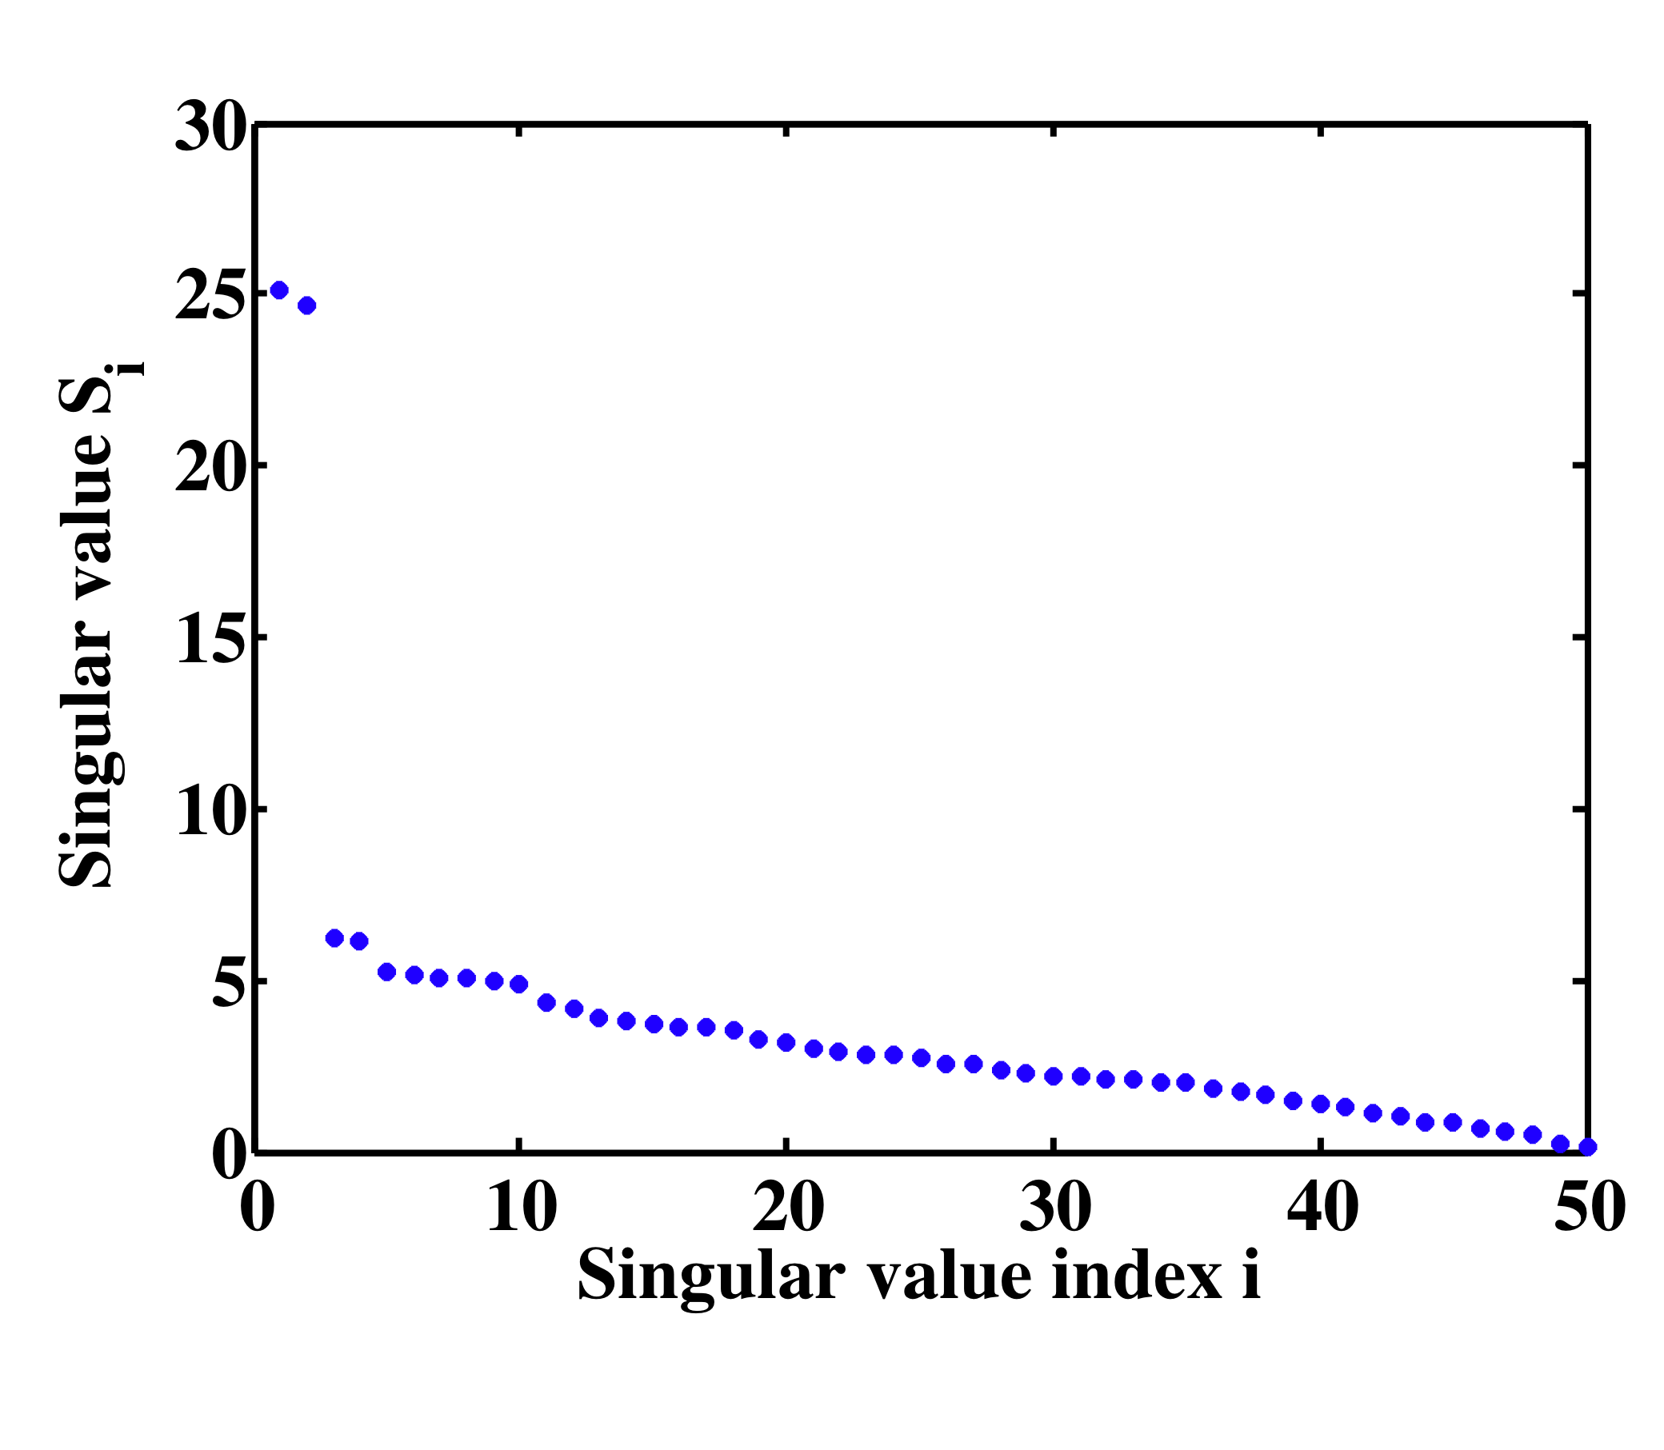
1D example
1 Real sinusoid is represented by 2 complex exponentials p=2

Slide 76
1D example
Signal
Noise

Slide 77
2D example (1D in FX)
M (view) is selected to make M (Hankel Matrix) close to a square matrix
Rest of the algorithm is very similar to FX- decon:
Decide min-max frequencies for noise attenuation
Window patching/unpatching
Adjust filter length (p in ssa) by monitoring residual panel
Use frequency domain symmetries to save time

Slide 78
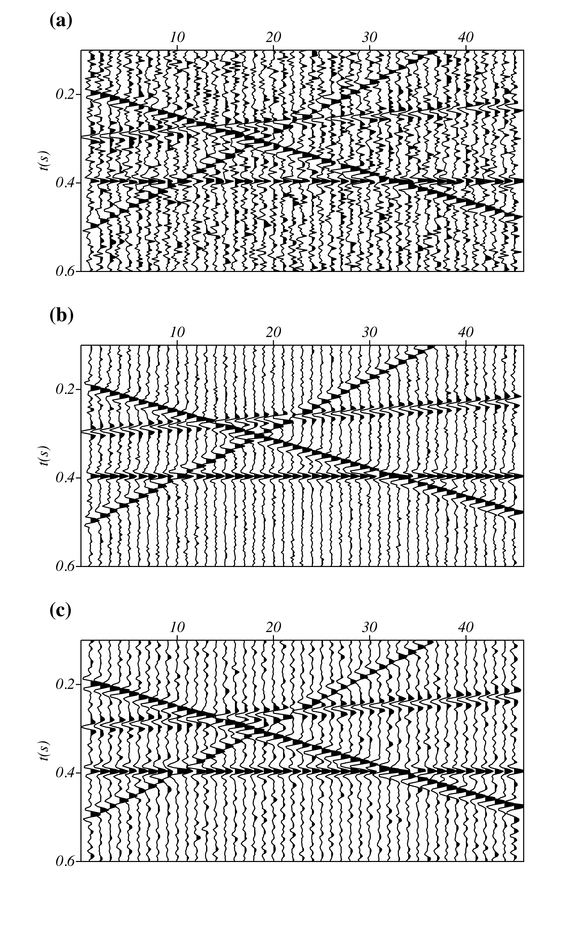
Data
FX SSA
FX Decon

Slide 79
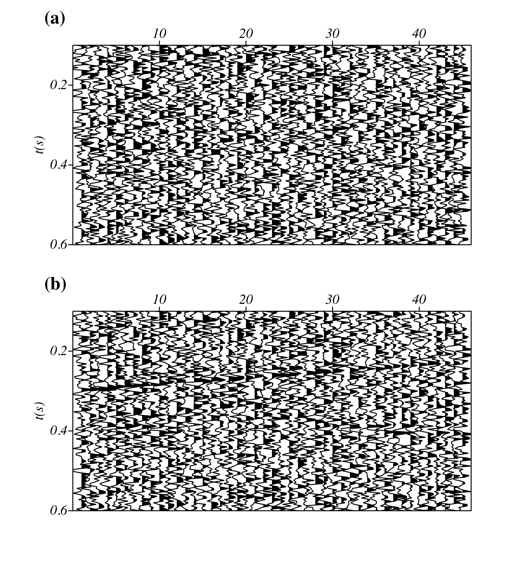
Error Panels
FX-SSA
FX-Decon

Slide 80
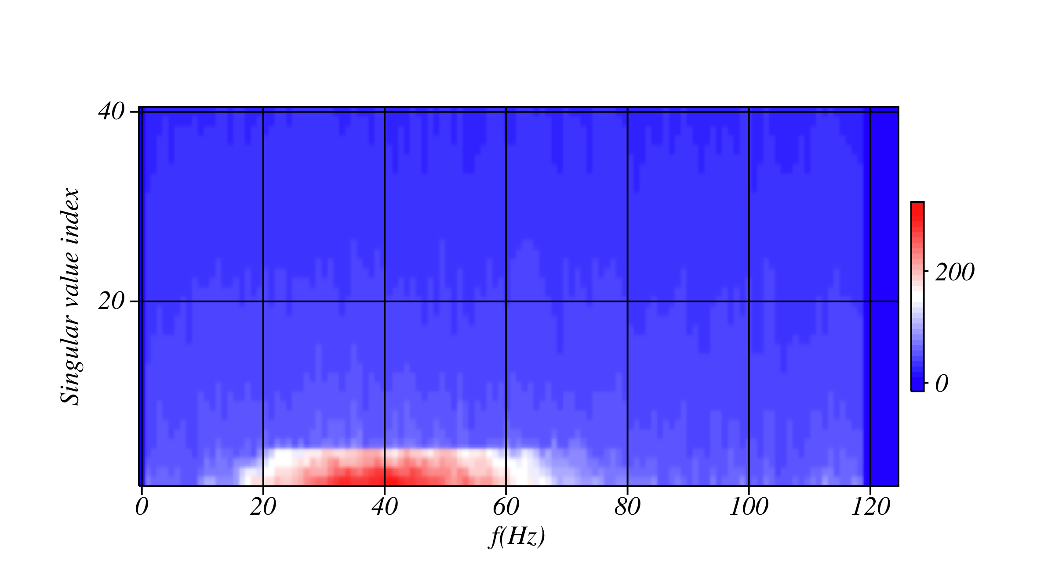
Spectrum of singular values vs. freq.
Spectra cut-off is at 4 singular values

Slide 81
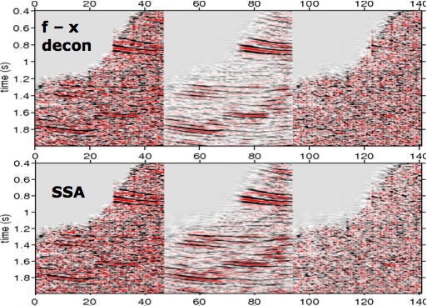
Marmousi gathers.

Slide 82
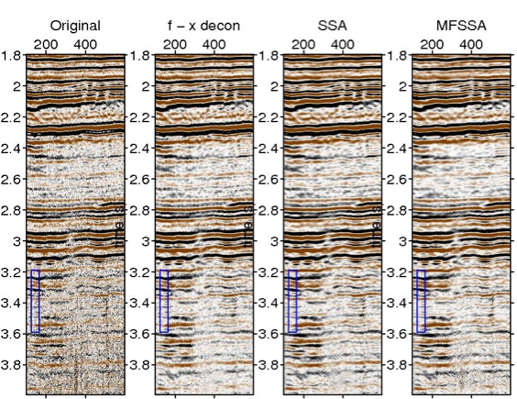
Real data comparison (Processing by V. Oropeza)

Slide 83
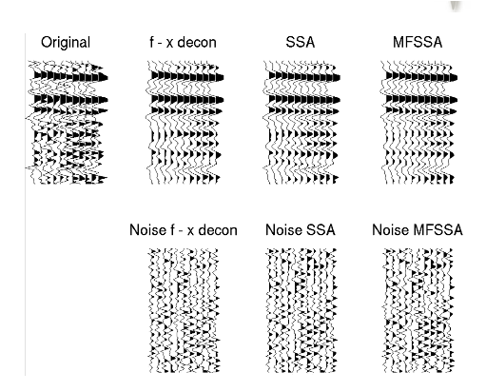
Comparison

Slide 84
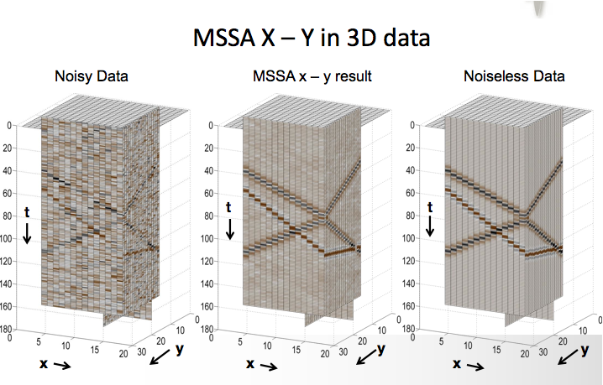
SSA for 3D cubes

Slide 85
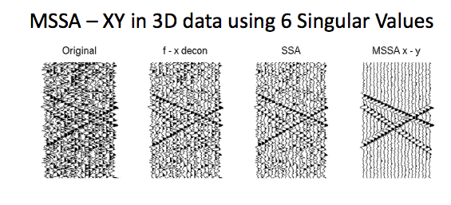
SSA works better in x-y-f than x-f (more data)

Slide 86
Notes:
RSVD (randomized SVD) can be used to speed up the SVD
For data reconstruction we used fast Lanczos solvers that exploits the structure of the Hankel matrix for fast rank reduction
These tricks are also used for data reconstruction
Gao, J., Sacchi, M., and Chen, X. (2013). ”A fast reduced-rank interpolation method for prestack seismic volumes that depend on four spatial dimensions.” GEOPHYSICS, 78(1), V21–V30.

